Slide 1
Site engine optimisation
Stephen Sangar
Web Officer - PAD

Slide 2
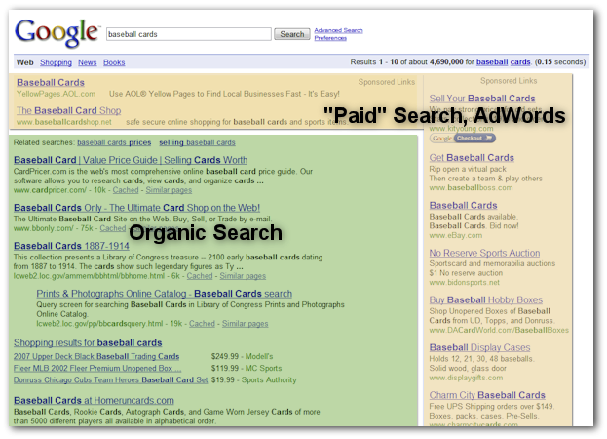
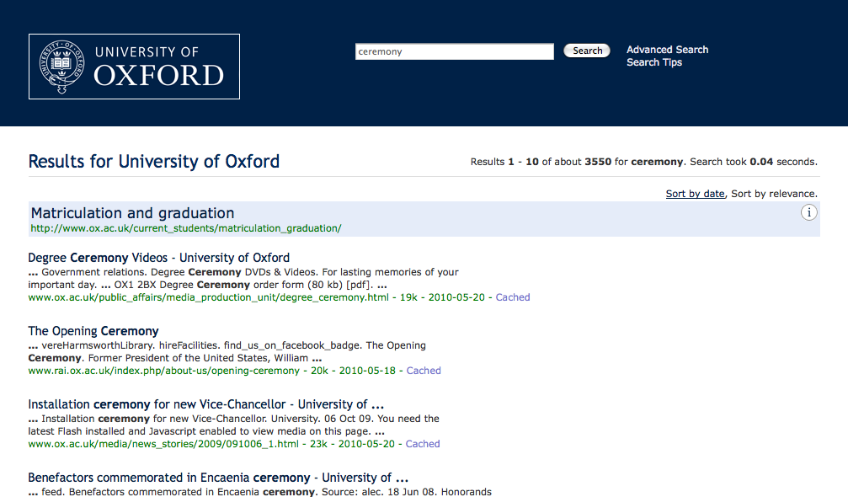
Typical results pages

Slide 3
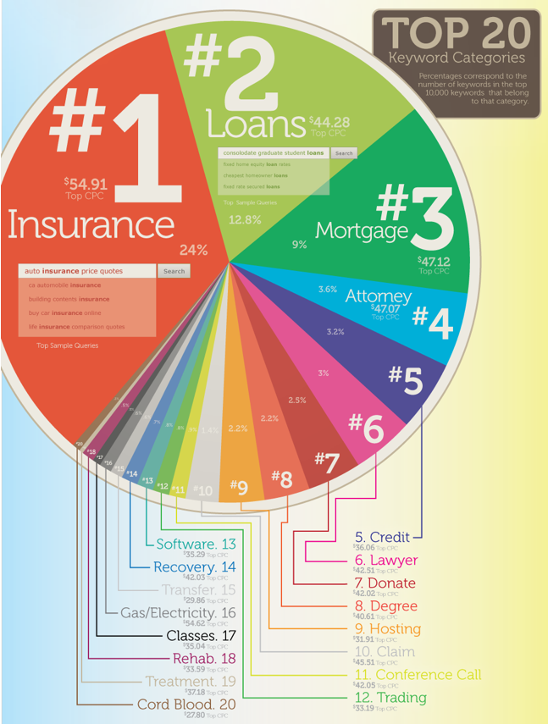
Most expensive adwords

Slide 4
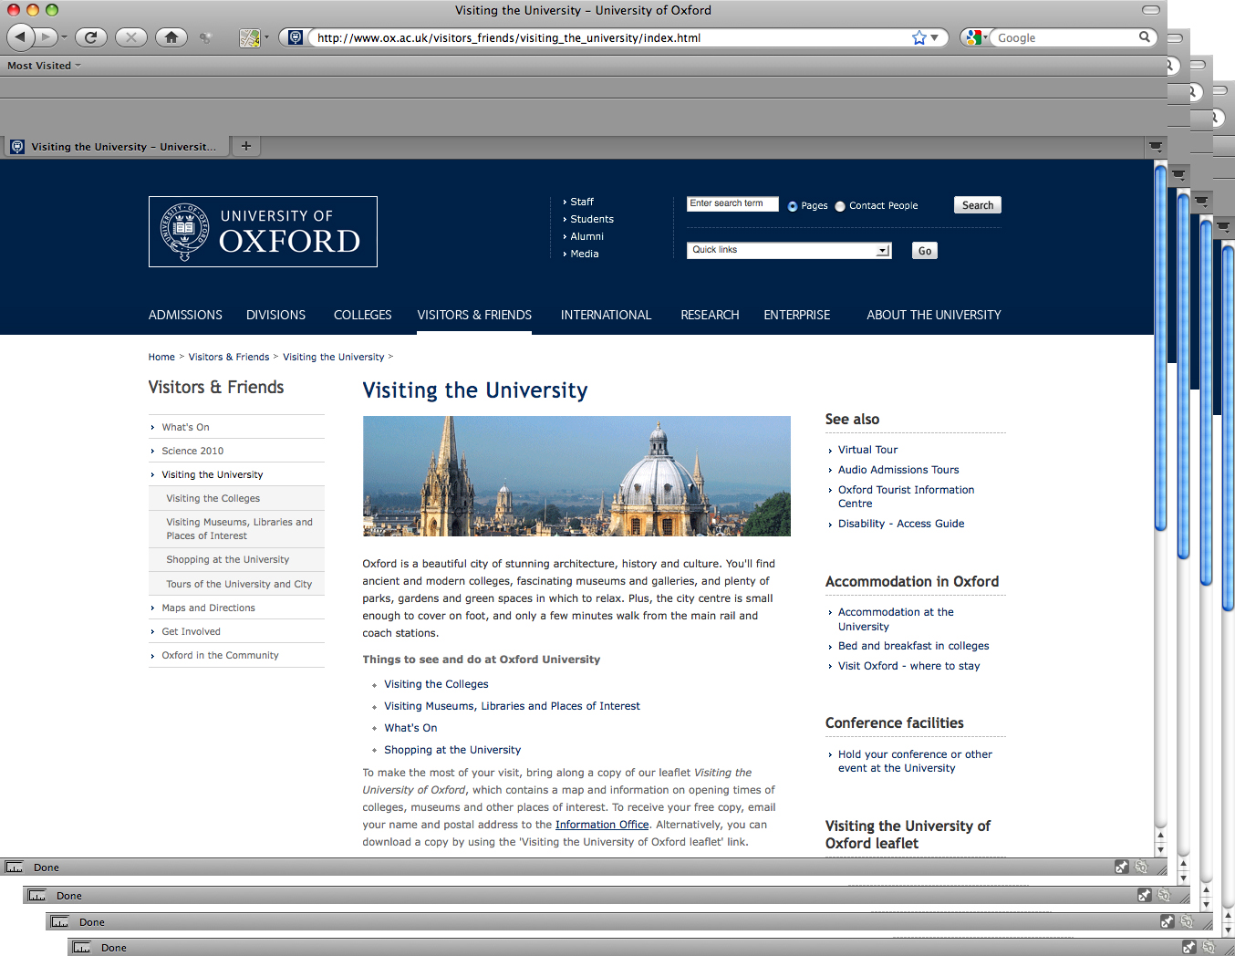

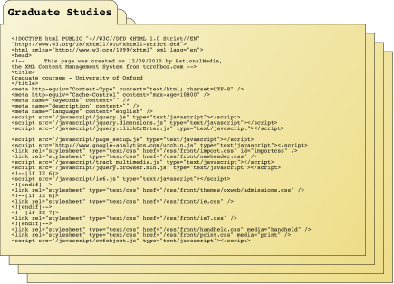
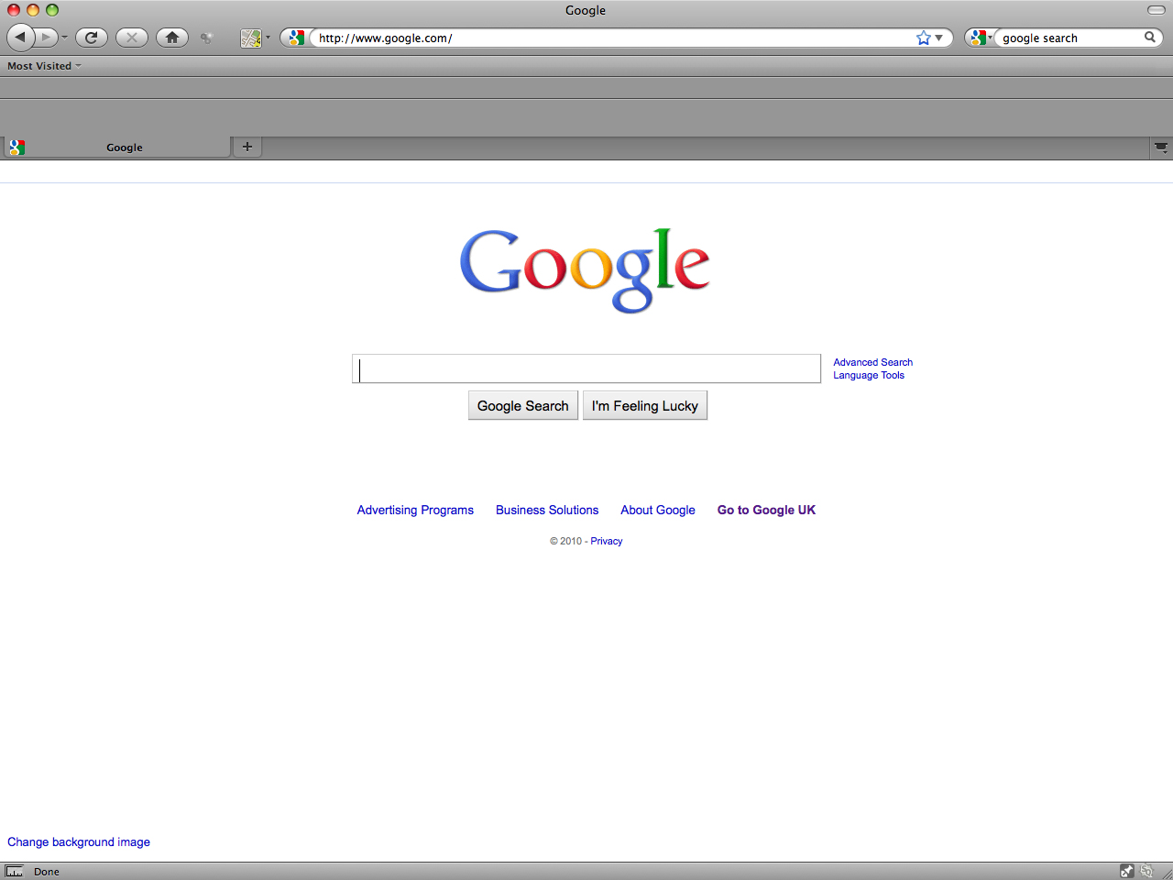
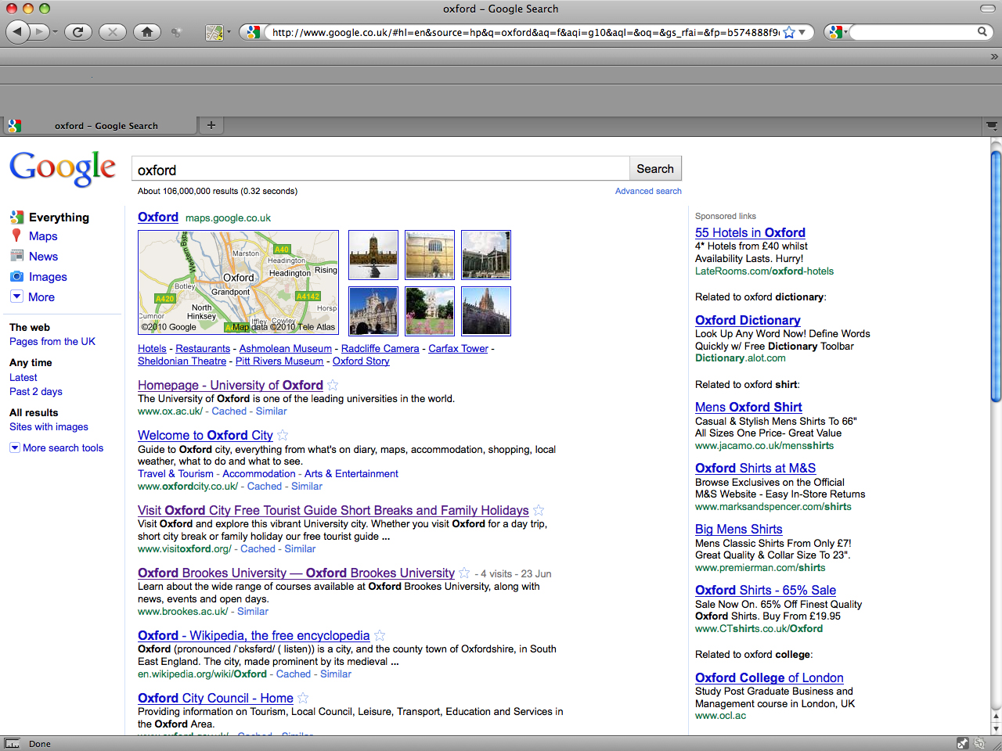
How does an organic search work?
crawls
Spider/Robot
  Web
  Pages
indexes
  Index
links
search
results
30 November 2011
Page 4

Slide 5
Keywords - Know your audience and page
30 November 2011
Page 5
Keywords are the query terms your audience uses
Query terms must be present on the page
Example: Olympics, university, competitors, London 2012, athletes

Slide 6
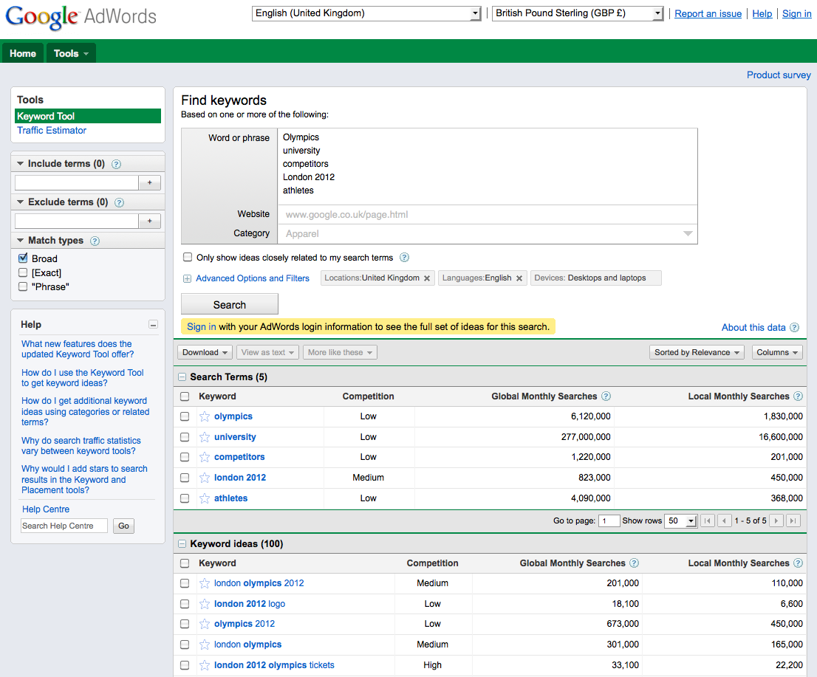
Adwords
30 November 2011
Page 6

Slide 7
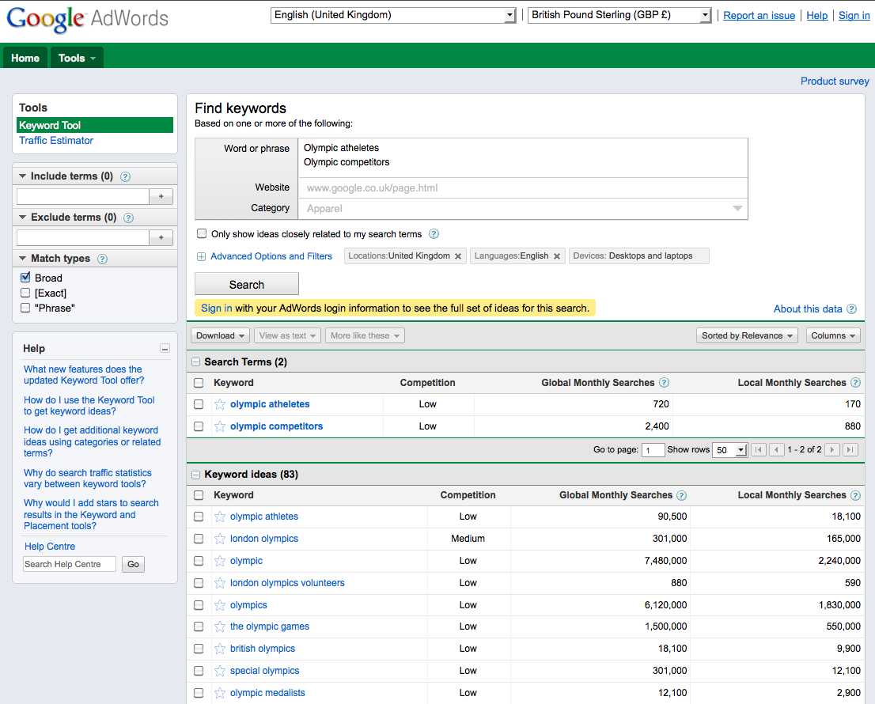
Adwords
30 November 2011
Page 7

Slide 8
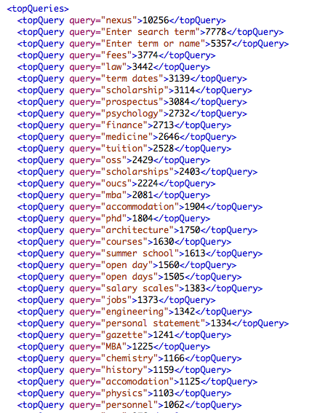
Internal data
30 November 2011
Page 8

Slide 9
Some key factors in SEO
30 November 2011
Page 9
Good, up-to-date content
Unique and accurate title (keyword(s) in title tag)
Keyword(s) in H1 tag
Keyword(s) density
Keyword(s) in metadata description
Keyword(s) in URL
External links coming in
Internal links/IA/Sitemap
Site reputation

Slide 10
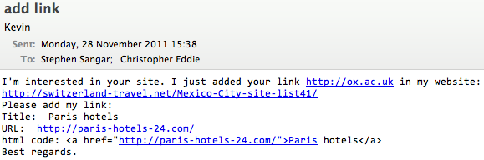
Link to me!
30 November 2011
Page 10

Slide 11
Example: Olympics site
30 November 2011
Page 11
Key words/phrases
  London Olympics 2012
  university Olympics
  university Olympic competitors

Slide 12
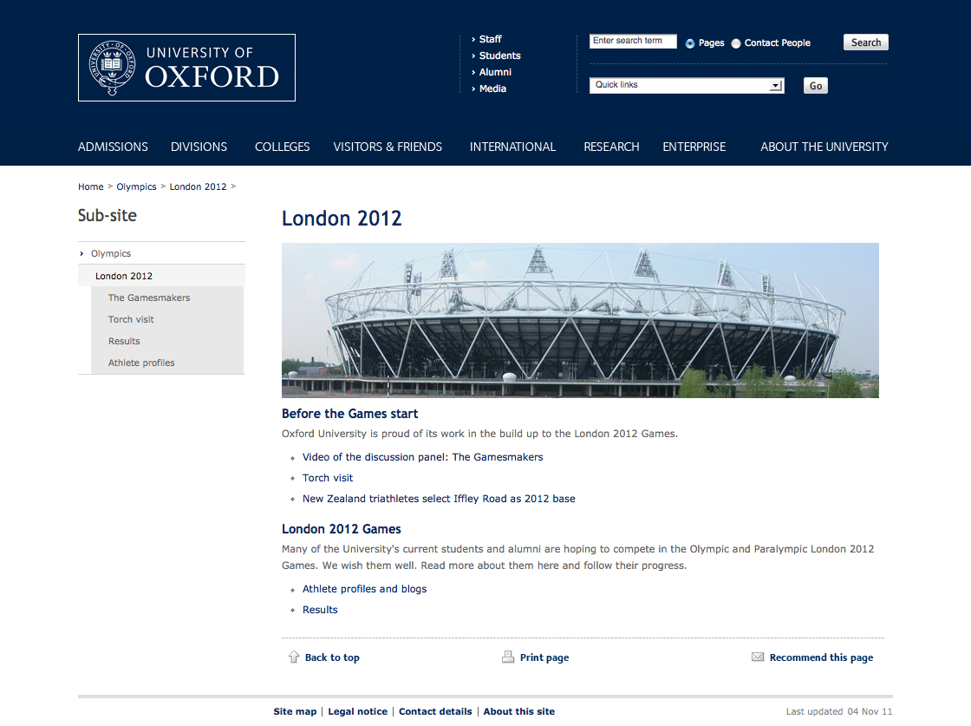
London Olympics 2012
Not in first 100 results
30 November 2011
Page 12

Slide 13
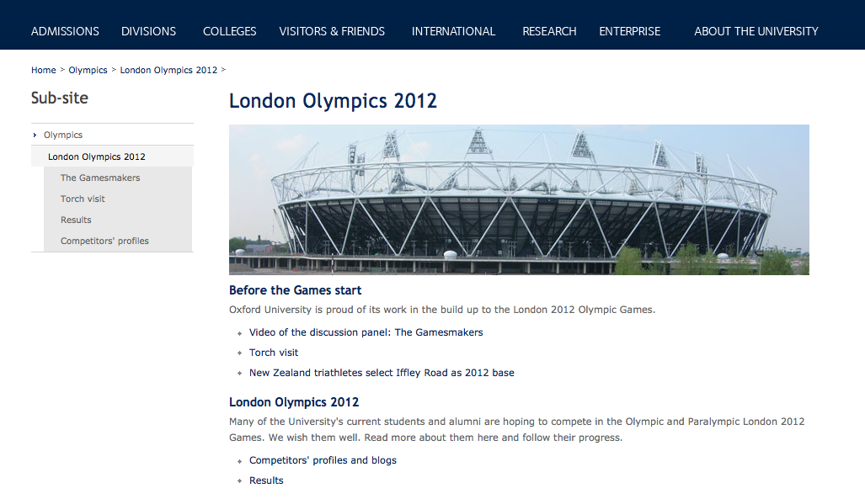
London Olympics 2012
Still not in top 100
30 November 2011
Page 13

Slide 14
London Olympics 2012
Some top results
30 November 2011
Page 14
Official website
Wikipedia
BBC
Telegraph
Guardian
ESPN
Tour guides
Visit London

Slide 15
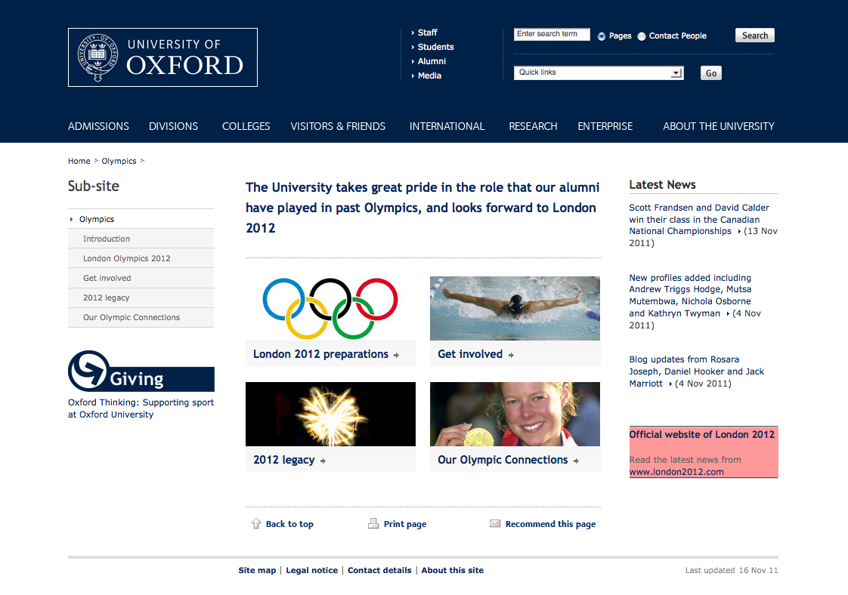
university Olympics
6th
30 November 2011
Page 15

Slide 16
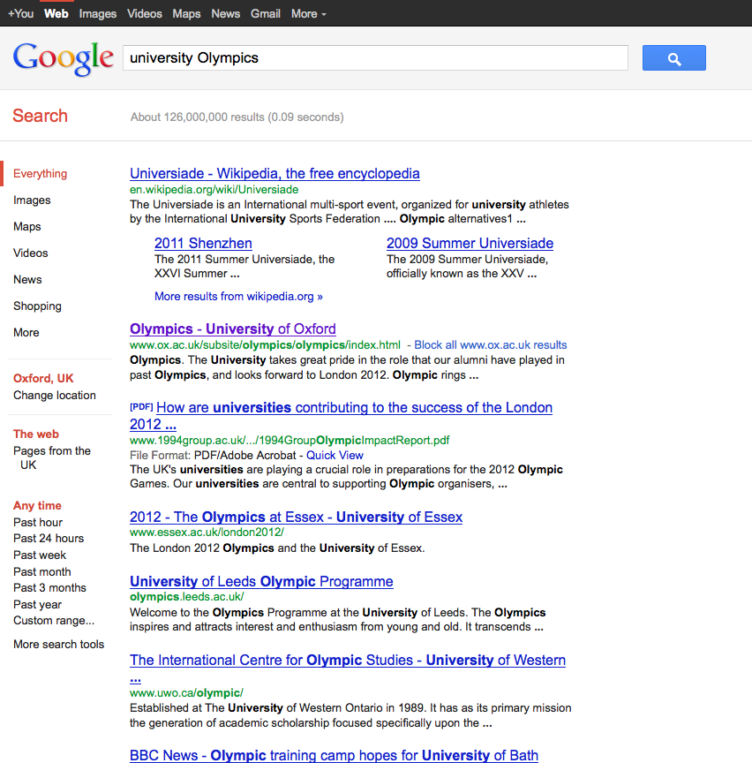
university Olympics
2nd
30 November 2011
Page 16

Slide 17
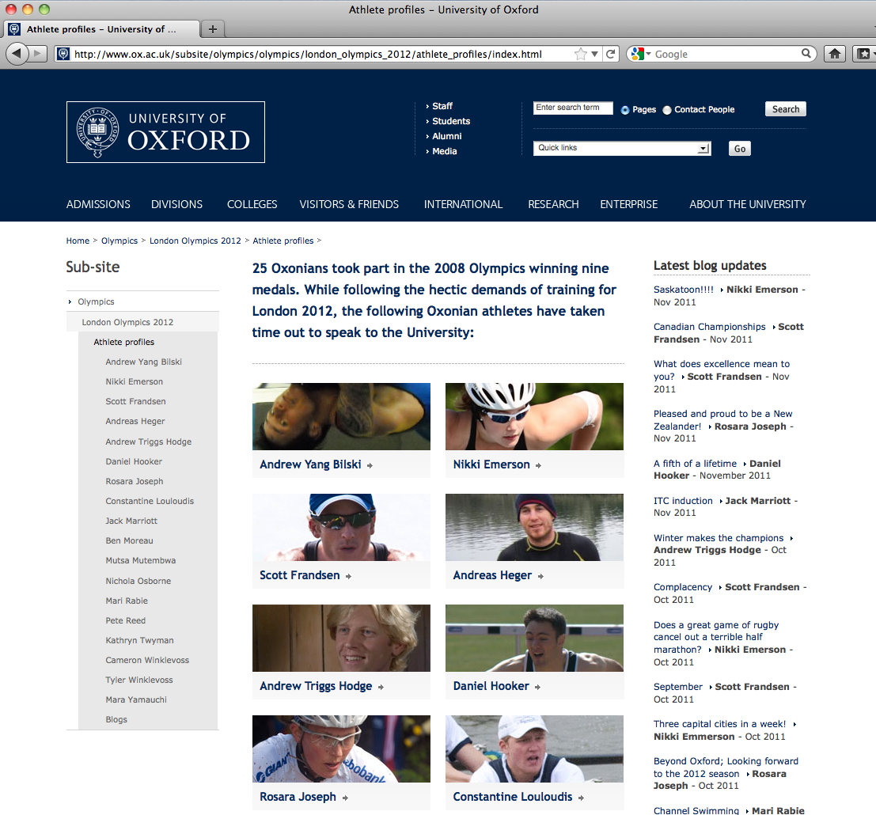
university Olympic competitors
Not in first 100
30 November 2011
Page 17

Slide 18
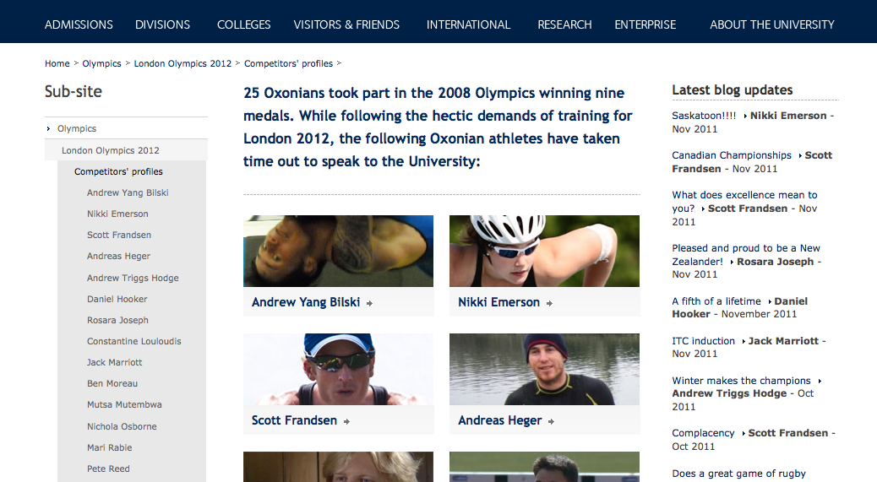
university Olympic competitors
Top of page 5
30 November 2011
Page 18

