Slide 1
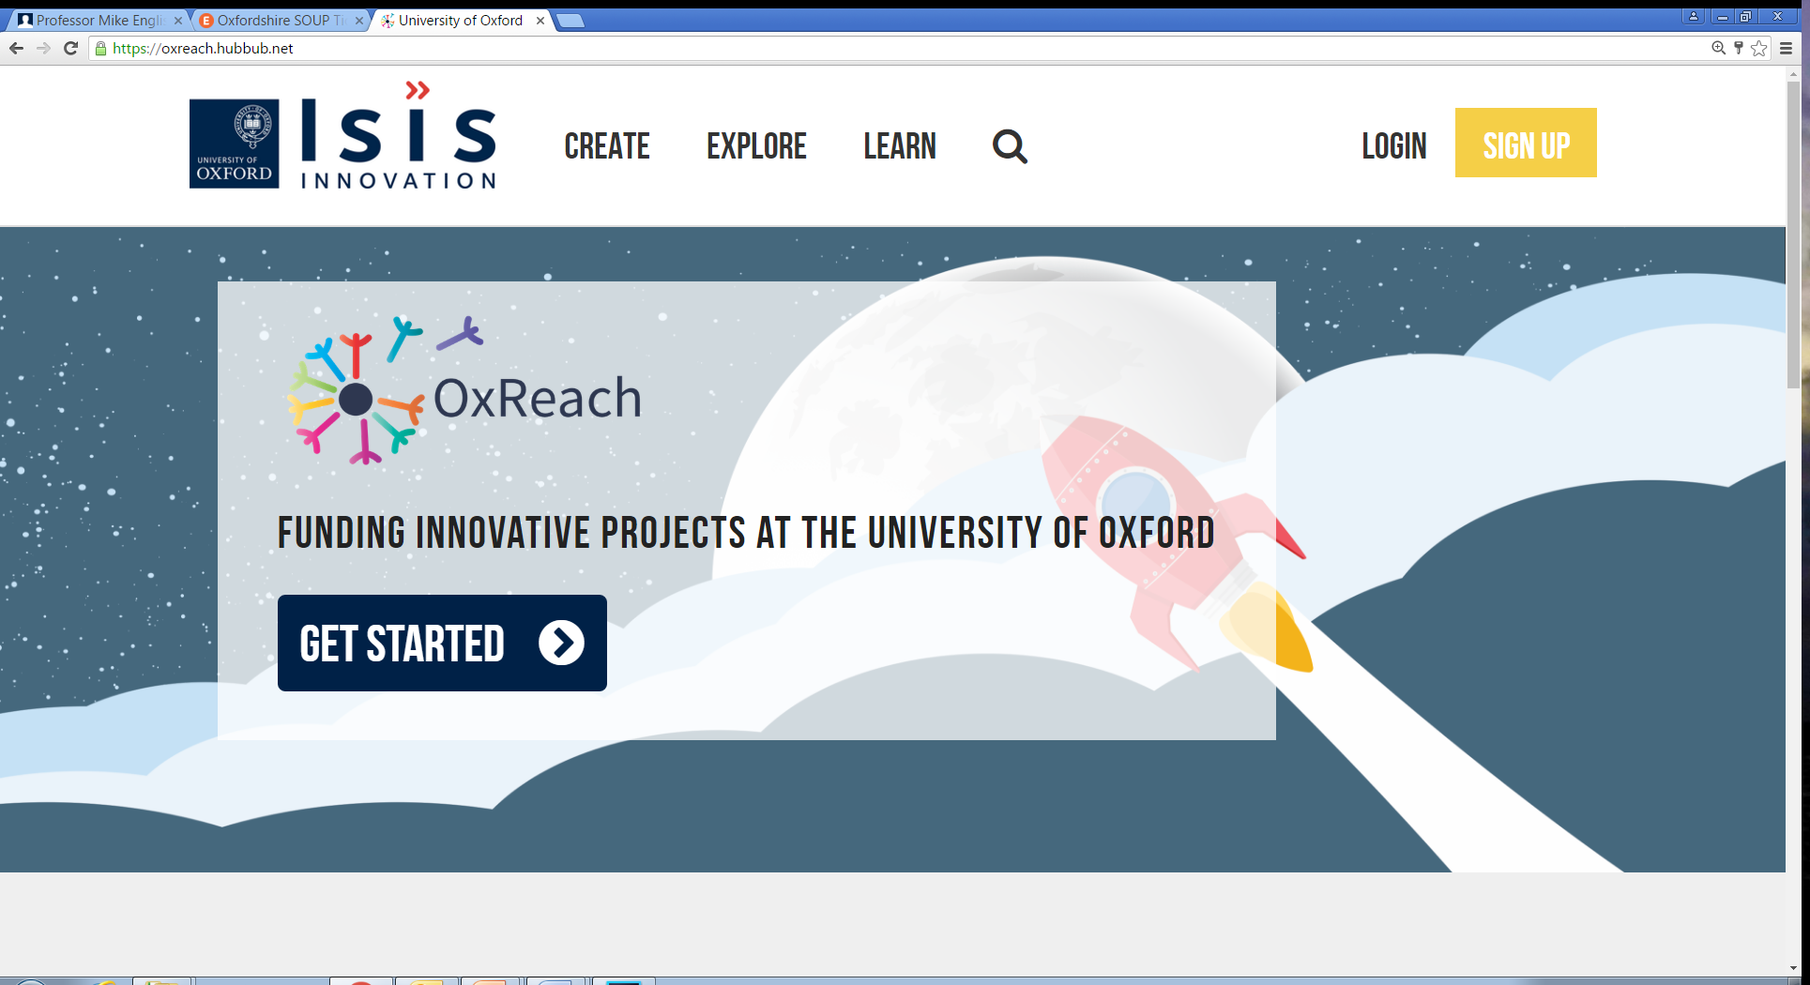
A rewards based crowdfunding platform for innovative, philanthropic projects from the University of Oxford
Notes:
Introduction – Pippa from OUI, I set up the University’s crowdfunding platform. Here to tell you about the first campaign. So if you would like to run a campaign in the future it will give you a few hints and tips.

Slide 2
Small sums of money from a large number of backers
Small token of thanks
Notes:
OxReach is a rewards based crowdfunding platform…

Slide 3
Through the platform members of the University can raise philanthropic funds for innovative, high impact campaigns with tangible social benefit.
OxReach is not a platform for raising equity finance, for debt, for campaigns with a commercial return or a means of raising money to fund research.
Notes:
The end result of all this work is:
A university branded platform
With no platform fees…
Specifically dedicated to Oxford University members
And with a great support crew

Slide 4
University Friendly Terms
Dedicated to Oxford
No Platform Fees
Fundraising Support
Notes:
So we decided to set up our own platform. Now this may be appropriate for you to use or not. But I just thought I would let you know it is there. And this was used for Mikes project. It has the following benefits…

Slide 5
Life-saving Instruction For Emergencies
Notes:
Introduction – Pippa from OUI, I set up the University’s crowdfunding platform. Here to tell you about the first campaign. So if you would like to run a campaign in the future it will give you a few hints and tips.

Slide 6
In Sub-Saharan Africa 1 million babies die within the first 28 days
620,000
of these deaths could be avoided
(WHO)
Notes:
This is the problem that he has been trying to solve. In sub-saharan Africa 1m babies die within the first 28 days. However the WHO estimate that over half of these deaths could have been avoided through proper implementation of existing healthcare programmes and proper training.

Slide 7
£63,126 from 178 donors
A game delivered on low-cost smartphones to give healthcare workers the up-to-date knowledge they need to provide life-saving treatment
75% new donors
0.63% view to donor
conversion rate
Notes:
So mike and his team developed life. Description of LIFE

Slide 8
The African Clubfoot Project
Notes:
Introduction – Pippa from OUI, I set up the University’s crowdfunding platform. Here to tell you about the first campaign. So if you would like to run a campaign in the future it will give you a few hints and tips.

Slide 9
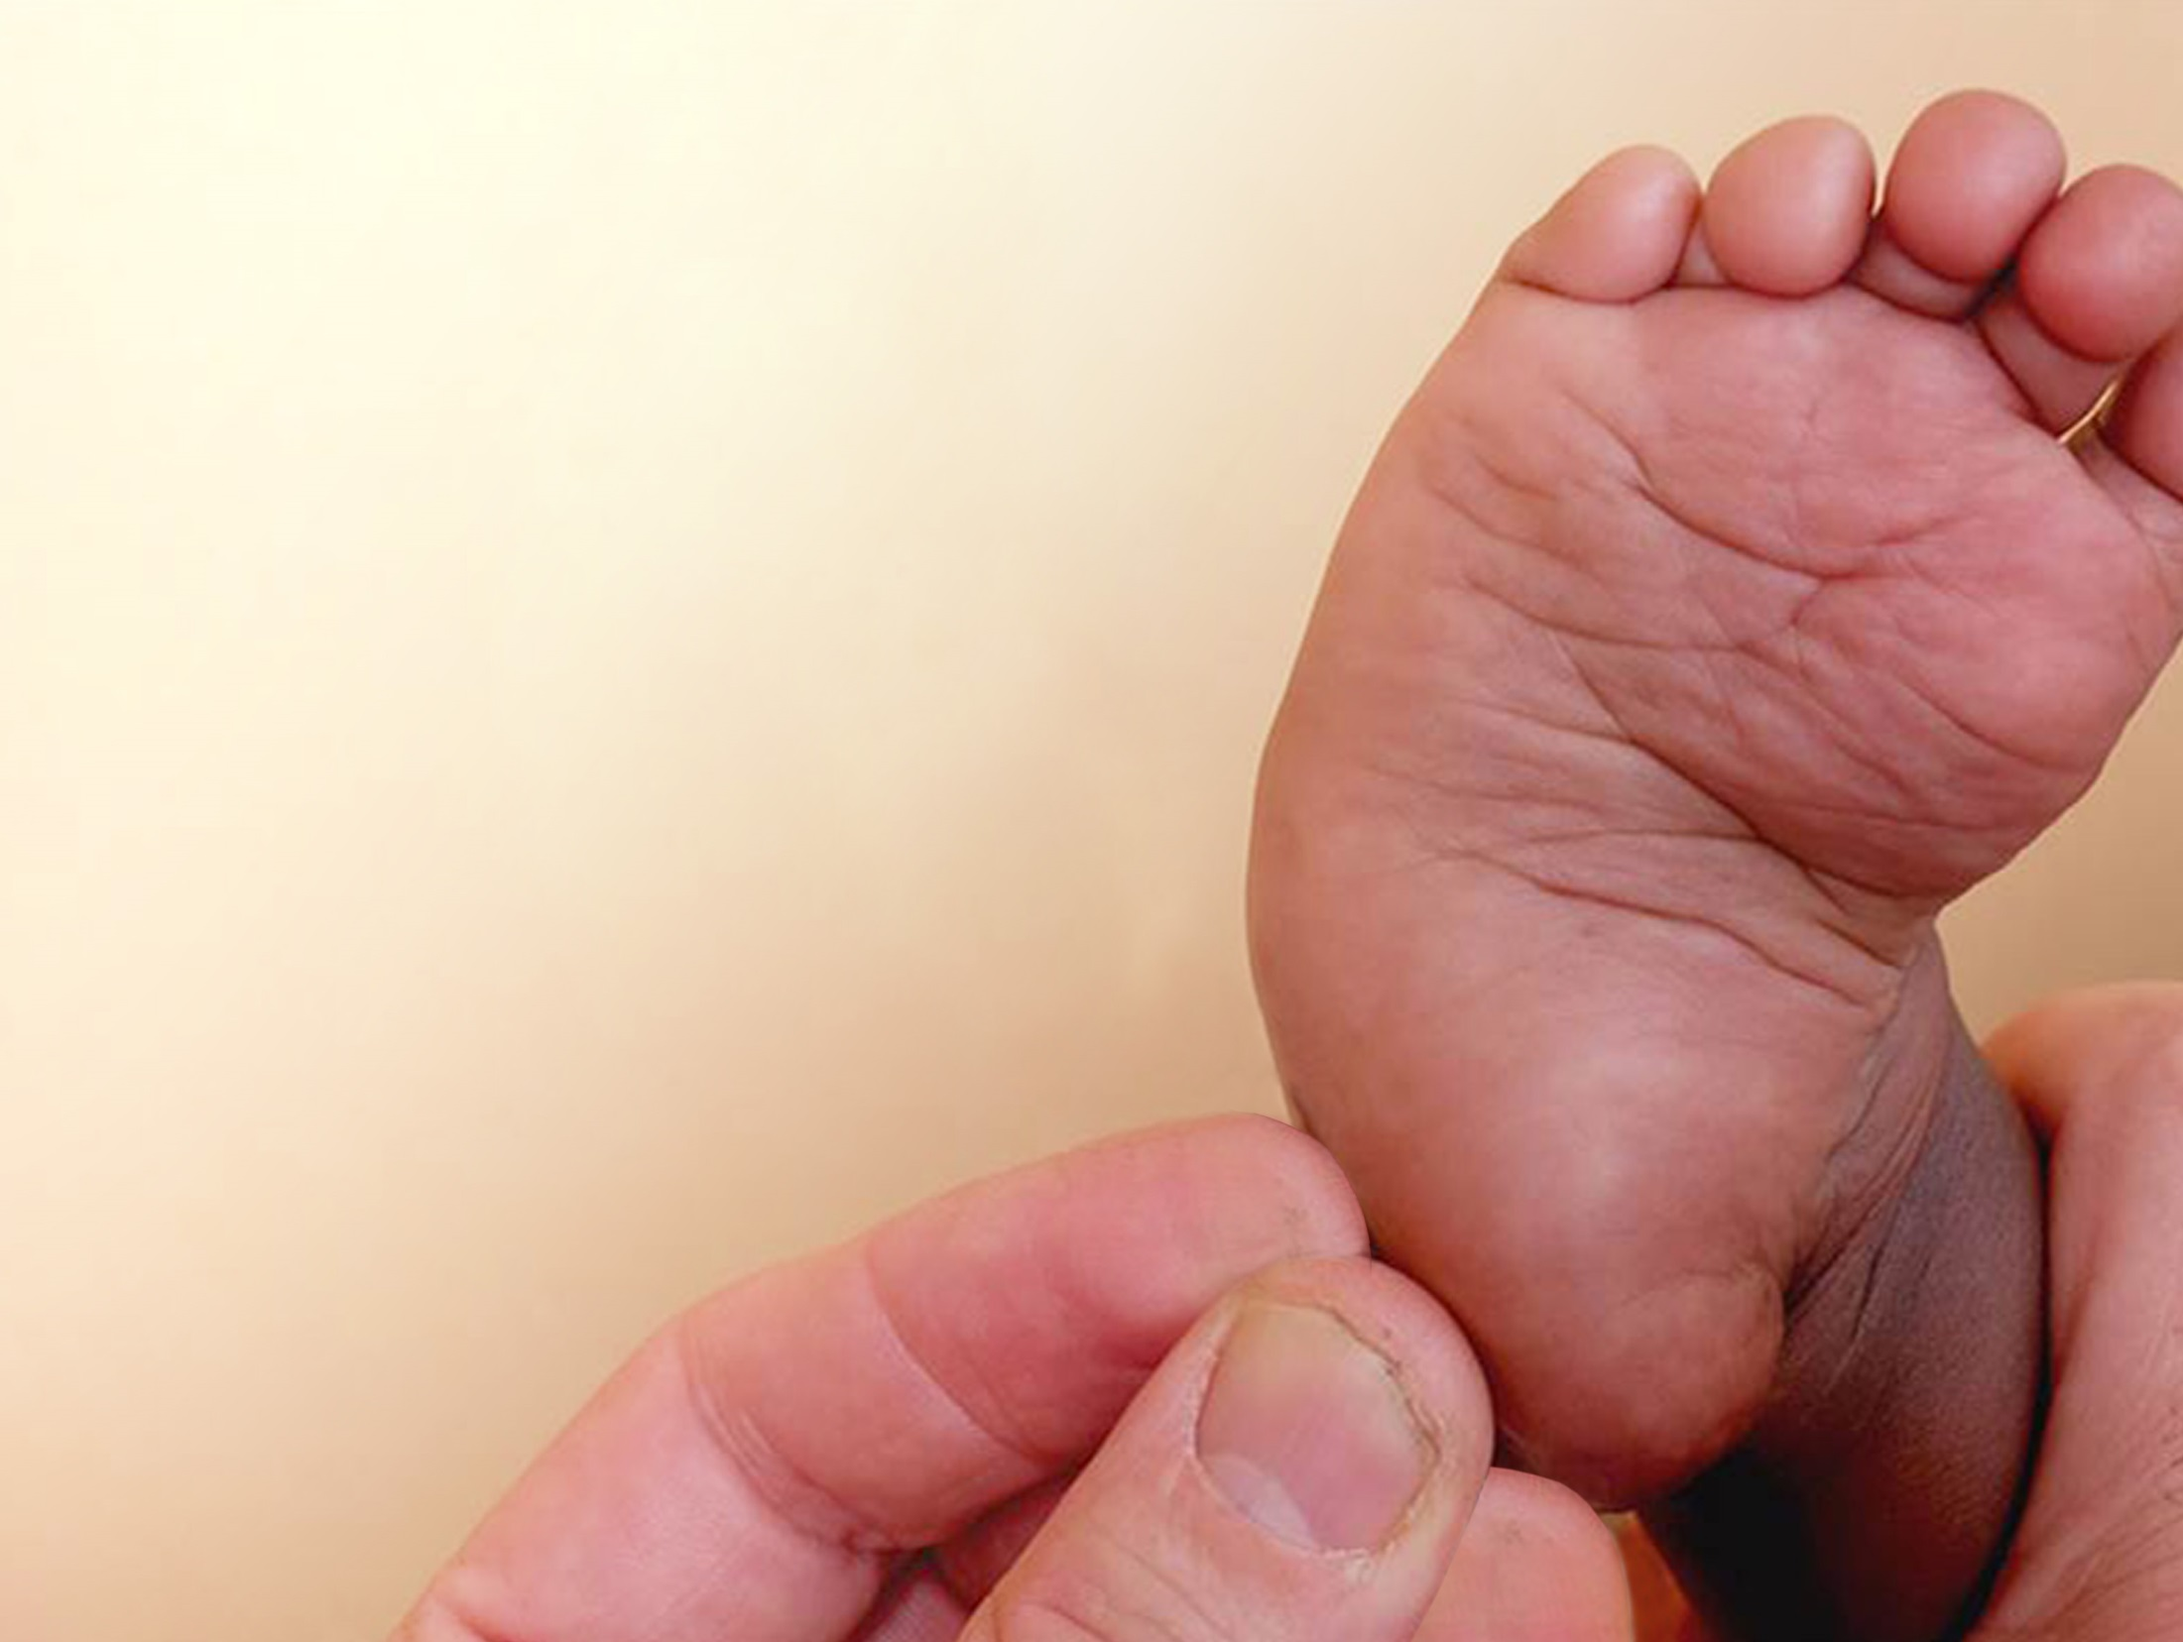
Clubfoot Training
More than 30,000 children in Africa are born with clubfoot each year.
Many thousands of these children get no treatment, as it is simply not available where they live.

Slide 10
£81,097
from 342 donors
Rolling out two courses across Africa, a Basic Clubfoot Treatment Provider training course and a Clubfoot 'Train The Trainer' course.
80% new donors
1.32% view to donor conversion rate

Slide 11
Blogs
Lancet Global Health
Healthy Newborn Network
(re-blog)
Press
Tech Radar
Radio
BBC Oxford
Jack FM
Media Used
Twitter
Facebook
Instagram
OX.AC.UK
Posters
Fliers
Notes:
Talk about all media used, but going to focus on social media today. Blogs and radio were to build credibility to the campaign, whilst the social media was to try and drive donors to the site. Social media was more of a direct ask, whilst blogs were more information based.

Slide 12
OX
Total Impressions
(twitter, Facebook, ox.ac.uk)
LIFE 264,027
Clubfoot 795,919
URL clicks
LIFE 4,600
Clubfoot 6,808
Total engagements
LIFE 6,555
Clubfoot 9,496
Retweets/shares
LIFE 624
Clubfoot 688
Likes
LIFE 1331
Clubfoot 959

Slide 13
4269 Clicks
16% OxReach views
2836 Clicks
11% OxReach views
Notes:
So we launched Mike’s project on 12th March for 4 weeks. Chose 4 weeks to give a sense of urgency to the campaign and also due to the time commitment required by the team.

Slide 14
34% UK
19% US
7% China
42% UK
12% US
8% China
Notes:
So we launched Mike’s project on 12th March for 4 weeks. Chose 4 weeks to give a sense of urgency to the campaign and also due to the time commitment required by the team.

Slide 15
Total traffic to Clubfoot campaign
Social media traffic
12%
7%
18%
Click to donate
Reddit conversation rate 33%
Notes:
Reddit – 6 people, only 2

Slide 16
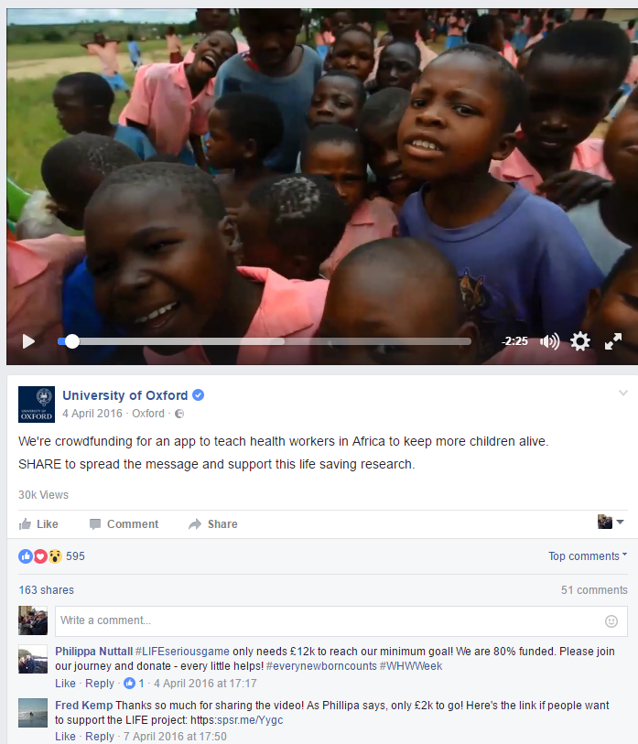
2314 engaged users
Total reach:
74,838 unique users

Slide 17
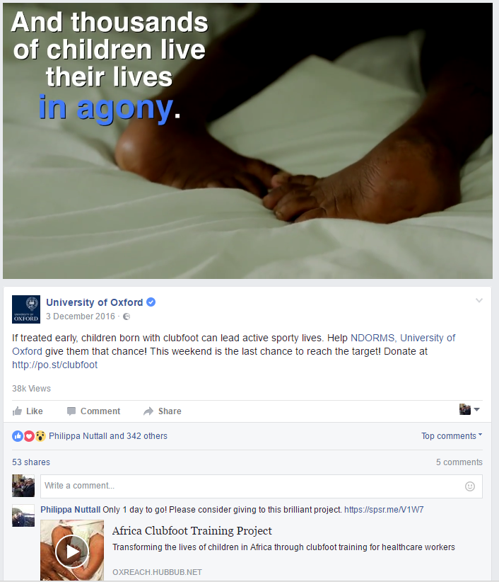
4606 engaged users
Total reach:
211,318 unique users

Slide 18
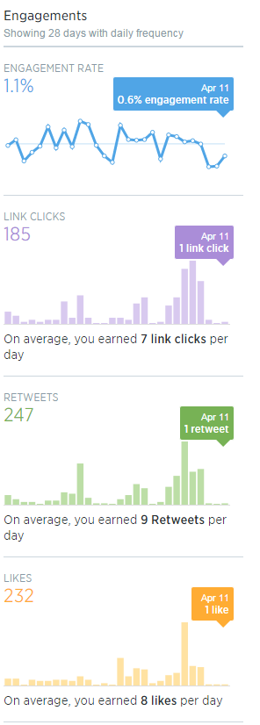
LIFE Twitter

Slide 19
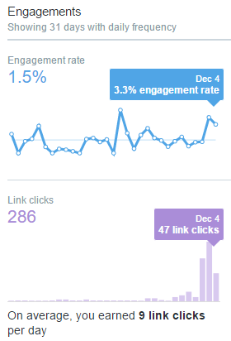
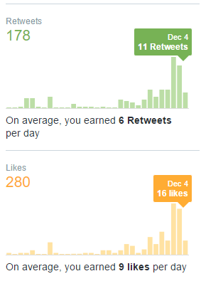
Clubfoot, OxReach Twitter

Slide 20
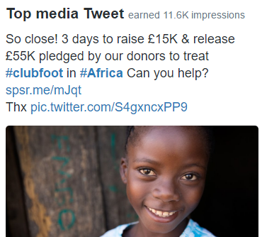
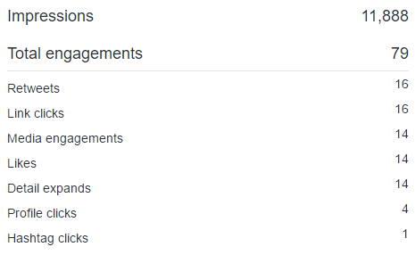
Highest Impression Tweets during campaigns

Slide 21
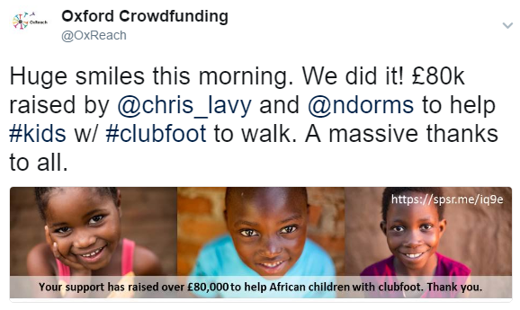
15,246 Impressions

Slide 22
Highest Engagements

Slide 23
LIFE Tweet Impressions vs Number of Donors
6th April
31st March
7th April

Slide 24
Engage with potential donors

Slide 25
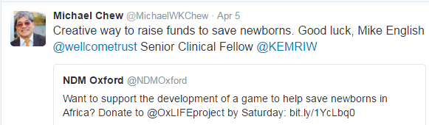
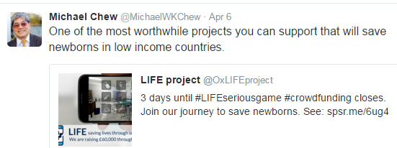
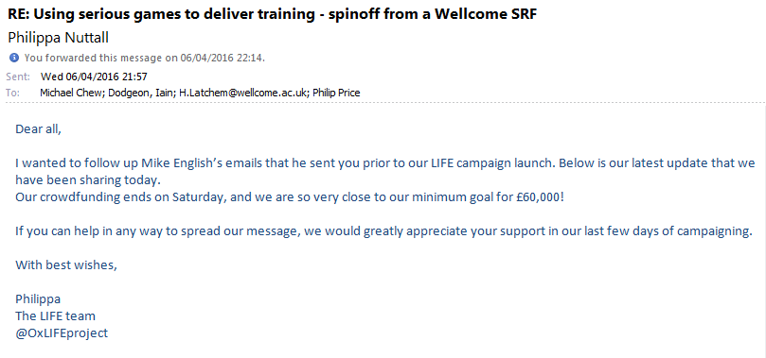
Use Your Networks
Donation on 8th April that pushed us over our minimum!

Slide 26
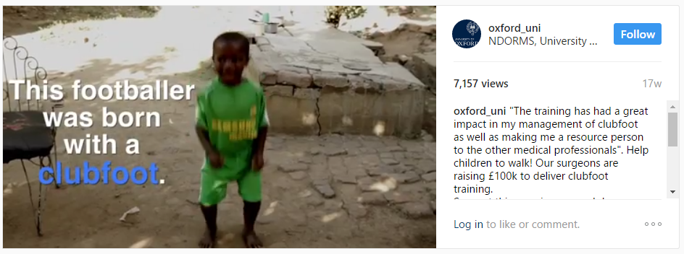
17% engagement rate!

Slide 27
Summary
Use Facebook more than twitter
OxReach has opened a gateway to new donors to the University
Explore Reddit?
Suite of videos for social media to ensure higher engagement
Secure match funding and publicity to add credibility
Conversion rate still low
Accept donations through North American Office?

Slide 28
Questions?

Slide 29
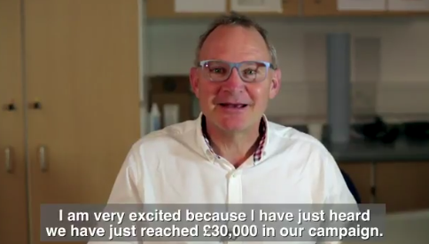
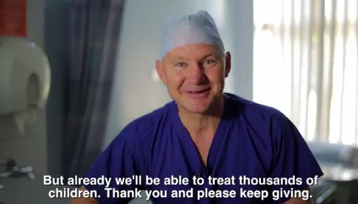
Create a video & extra milestone videos
Projects with videos are 147% more likely to achieve their funding targets

Slide 30
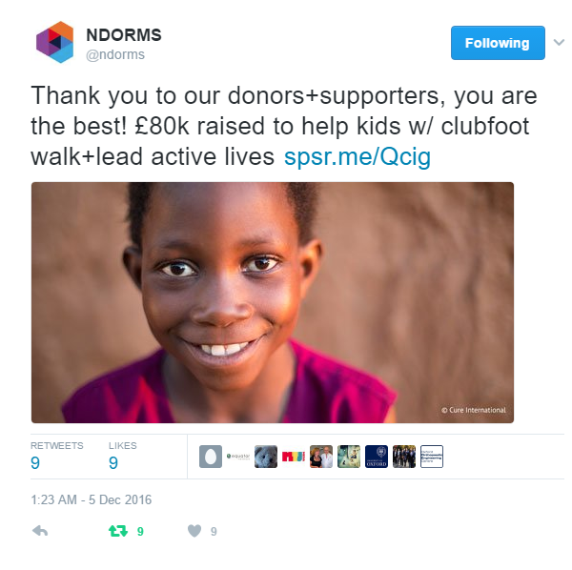
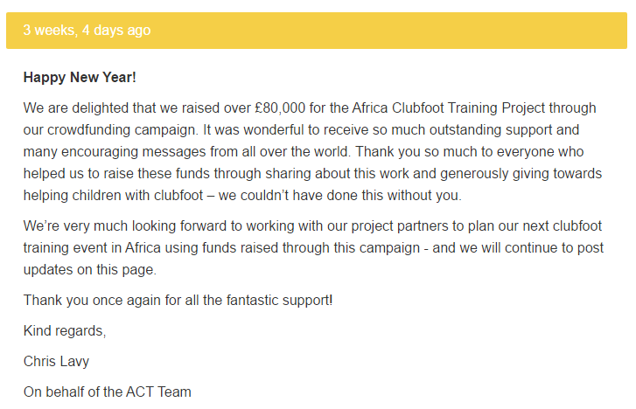
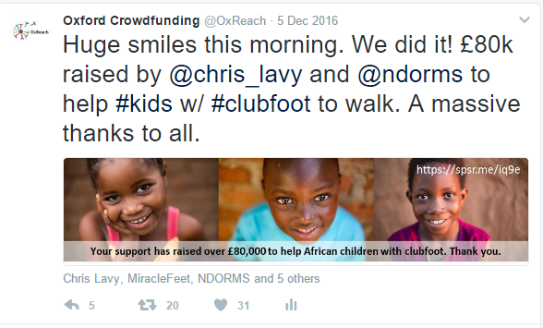
Say thank you

Slide 31
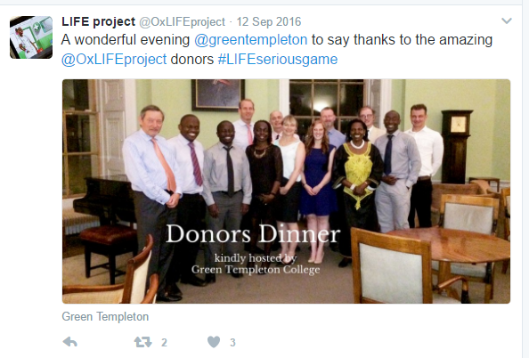
Deliver your rewards on time

Slide 32
6th April 2016
@OxLIFEproject

Slide 33
Our first tweet

Slide 34
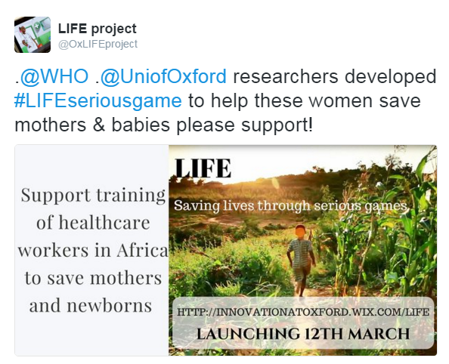
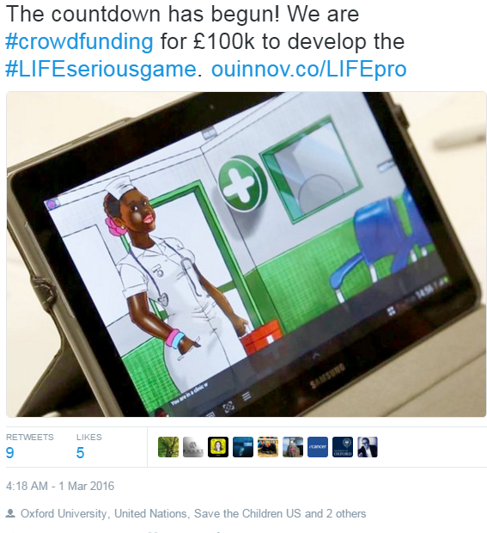
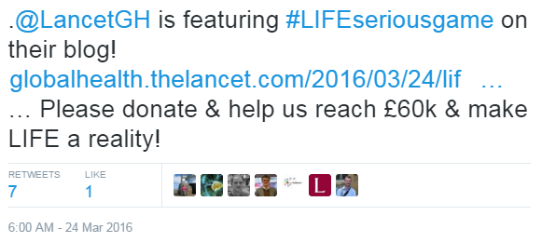
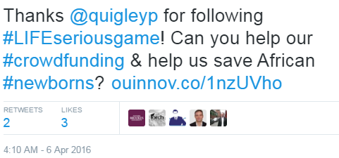
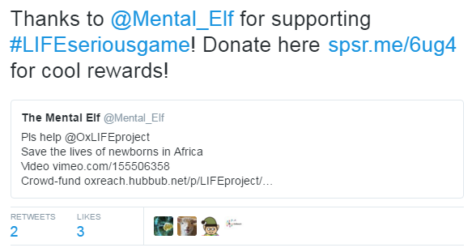
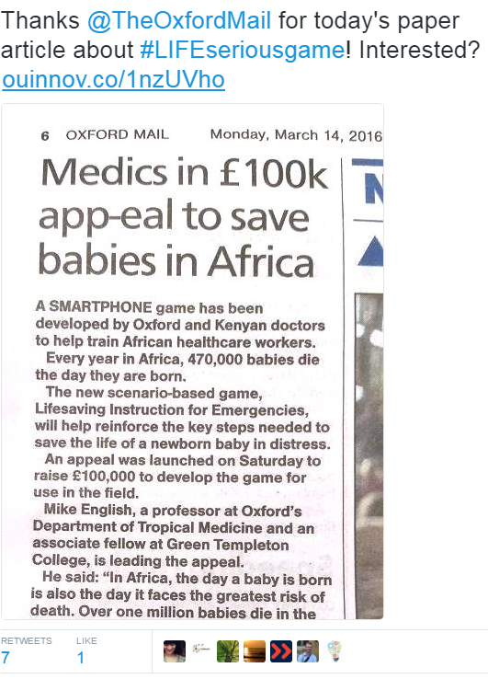
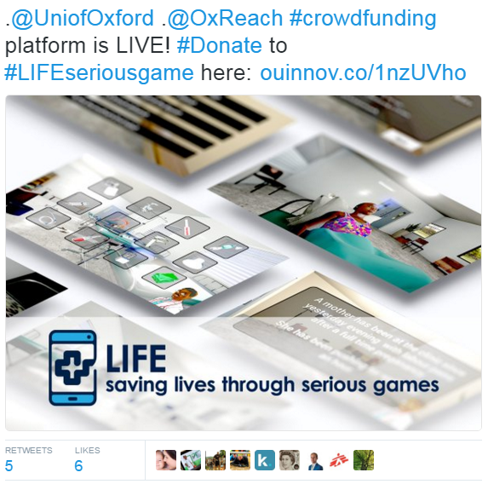
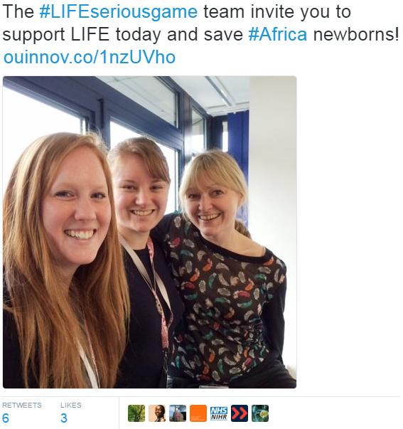

Slide 35
Highest Impressions
impressions | 4263 | 3117 | 2873
engagements | 35 | 8 | 43
engagement rate | 0.00821 | 0.002567 | 0.014967
retweets | 14 | 2 | 7
replies | 0 | 0 | 0
likes | 19 | 1 | 5
user profile clicks | 0 | 3 | 1
url clicks | 1 | 1 | 19
hashtag clicks | 0 | 1 | 1

Slide 36
Highest Retweets
impressions | 734 | 4263 | 2695 | 2237
engagements | 23 | 35 | 50 | 39
engagement rate | 0.031335 | 0.00821 | 0.018553 | 0.017434
retweets | 19 | 14 | 9 | 9
replies | 1 | 0 | 0 | 0
likes | 1 | 19 | 5 | 6
user profile clicks | 1 | 0 | 14 | 4
url clicks | 0 | 1 | 14 | 10
hashtag clicks | 0 | 0 | 0 | 0

Slide 37
Highest Likes
impressions | 4263 | 2237 | 1352 | 2192
engagements | 35 | 39 | 24 | 19
engagement rate | 0.00821 | 0.017434 | 0.017751 | 0.008668
retweets | 14 | 9 | 5 | 5
replies | 0 | 0 | 0 | 0
likes | 19 | 6 | 6 | 6
user profile clicks | 0 | 4 | 4 | 1
url clicks | 1 | 10 | 6 | 3
hashtag clicks | 0 | 0 | 0 | 0

Slide 38
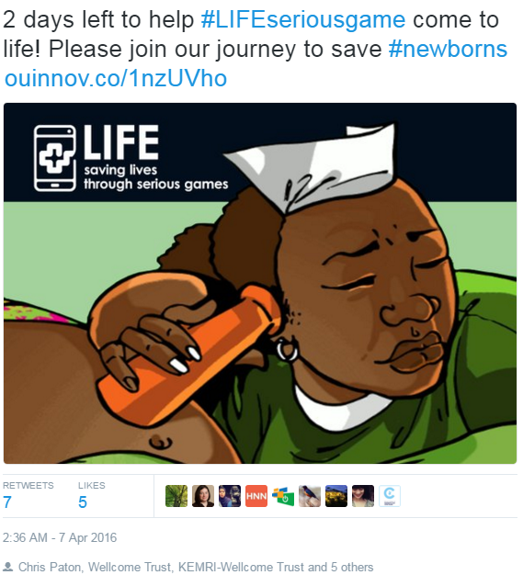
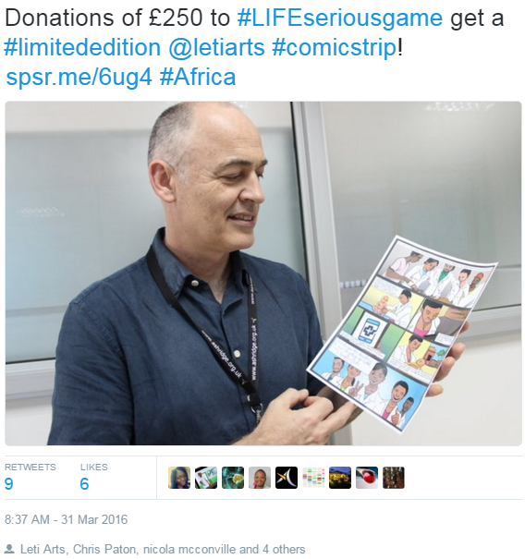
Highest URL click
impressions | 2873 | 2695 | 2237
engagements | 43 | 50 | 39
engagement rate | 0.014967 | 0.018553 | 0.017434
retweets | 7 | 9 | 9
replies | 0 | 0 | 0
likes | 5 | 5 | 6
user profile clicks | 1 | 14 | 4
url clicks | 19 | 14 | 10
hashtag clicks | 1 | 0 | 0

Slide 39
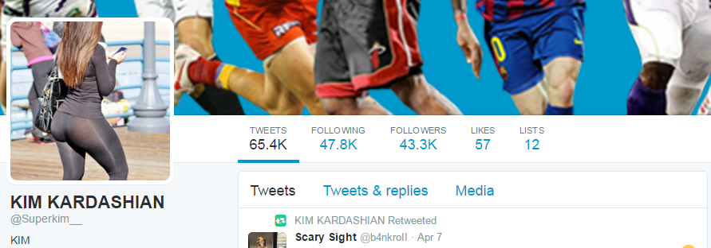
Highest Retweets
Including a RT from….

Slide 40
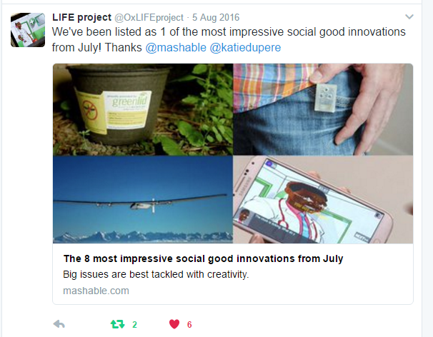
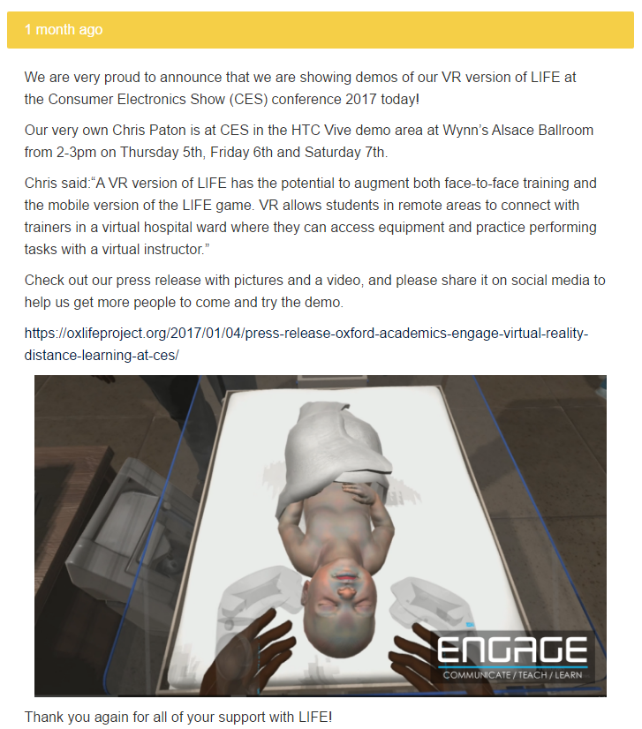
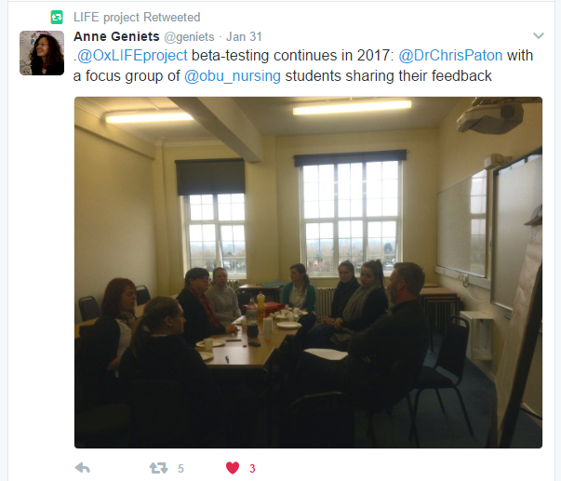
Update on progress

Slide 41
Previously Unknown Sponsors
Sponsors From Close Networks
Benefits
Crowdfunding matched by the Wellcome Trust ISSF.
Winner of the Saving Lives at Birth challenge (cash prize).
Developed a VR demo in partnership with HTC and VRImmersiveEducation. Unveiled at CES 2017.
Listed on Mashable as one of the 9 most impressive social good innovations.
Featured in Oxford University Annual Report 2015/16.
24% of donations
76% of donations
Mean: £64.59
Mean: £173.52
Mode: £25
Mode: £25
Notes:
To give you a breakdown of the donor stats. 24% came from people we did not know and 76% from close networks. Showing you just how important these close networks are. So all members of your team really need to map and push strongly to their immediate connections. These people know you and have the largest incentive to give. Interestingly the modal donation was the same for both groups, however the mean was higher from those that you knew.

Slide 42
Clubfoot twitter stats
Ndorms: impressions=142637, engagements =1473, likes=268, url clicks=152, retweets=278
Grace: impressions=2159, engagements=56, likes=37, url clicks=4, retweets=4
Chris Lavy: impressions=23716, engagements=394, likes=153, url clicks=35, retweets=67
Oxreach: impressions=123137, engagements=1714, likes=301, url clicks=316, retweets=199
UoO: impressions=149960, engagements=1253, likes=200, url clicks=179, retweets=140
Total twitter: impressions=441609, engagements=4890, likes=959, url clicks=686, retweets=688
Total twitter plus facebook, ox.ac.uk: impressions=354310+441609=795919, engagements=4890+4606=9496, Clicks=686+2836+3286=6808, retweets/shares=688

