Slide 1
Public Affairs Directorate
Brand Matters
1 May 2014 • Paul Chinn

Slide 2
Public Affairs Directorate
History
Brandr – Ancient Norse: to burn
950 A piece of wood that’s burning
1385 A torch
1552 The mark made by burning
1665 A mark made on cattle

Slide 3
Public Affairs Directorate
History
1827 A trade-mark made on a product
1854 A particular class of goods
1958 The impression of a product in the minds of consumers

Slide 4
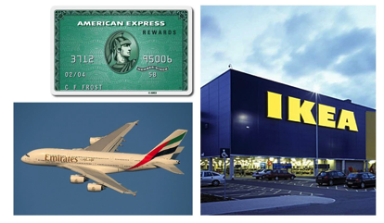
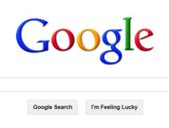
Public Affairs Directorate
History
1980+ Globalisation, brand as company identity, brand loyalty: offers benefits of belonging
2000+ Digital globalisation, brand usefulness, sense of taking part: networks

Slide 5
Public Affairs Directorate
One brand definition
A ‘name, term, design, symbol, or any other feature that identifies one seller’s good or service as distinct from those of other sellers. The legal term for brand is trademark. A brand may identify one item, a family of items, or all items of that seller. If used for the firm as a whole, the preferred term is trade name.’
American Marketing Association

Slide 6
Public Affairs Directorate
Another
Your brand is what people say about you when you’re not in the room.
Jeff Bezos, Founder, Amazon

Slide 7
Public Affairs Directorate
A better definition
The set of ideas a company or product stands for in people’s minds
Shaped by that company or product’s actions
And recognised through a visual style
Robert Jones, Professor at University of East Anglia and head of new thinking at Wolff Olins.

Slide 8
Public Affairs Directorate
The set of ideas a company or product stands for in people’s minds
Shaped by that company or product’s actions
And recognised through a visual style

Slide 9
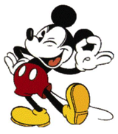
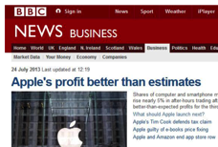
Public Affairs Directorate
Child and family entertainment
Intuitive technology, communication
and entertainment
Authority and
trustworthy
Organised information
Elite sport, celebration and entertainment
Old houses, gardens,
activities, family and fun

Slide 10
Public Affairs Directorate
The set of ideas Oxford stands for in people’s minds…
world-class • traditional • academic excellence • tutorial • elitist • exclusive • innovative • research • teaching • culture • politics • power • architecture • dreaming spires • establishment • authoritative • expert • publishing • sport • rowing • oxford blue • wealthy • expensive • posh
Audience brainstorm

Slide 11
Public Affairs Directorate
Vision
The University of Oxford aims to lead the world
in research and education. We seek to do this
in ways which benefit society on a national and
a global scale. We will build on the University’s long traditions of independent scholarship and academic freedom while fostering a culture in which innovation plays an important role.
Strategic Plan 2013–2018

Slide 12
Public Affairs Directorate
Aspirations
To develop our capacity to generate and share knowledge in the UK, Europe, and globally ensuring significant contributions to public policy-making and economic growth.
To work effectively with other institutions and organisations, where such partnerships can lead to outstanding research and teaching.
To enhance structures for collaboration across departments, colleges, and the University.
To fulfil the aims that no potential student should be deterred from applying to Oxford by financial or other barriers and that no student’s success should be hampered by financial difficulties.

Slide 13
Public Affairs Directorate
Aspirations
To ensure, through a commitment to the personal education of each student, a quality of education and experience which enables students to apply the values, skills, and intellectual discipline they have acquired in their future lives and careers, and which generates a lifelong sense of connection with Oxford.
To contribute effectively to the cultural, social, and economic life of the city of Oxford and the Oxfordshire region.
To recruit and retain the best academic staff and ensure that under-represented groups have equality of opportunity in recruitment, personal development, and career progression in all areas of employment in the University.

Slide 14
Public Affairs Directorate
Reputation
1
2
3
4
5
6
7
8
9
10
Institution
Harvard
MIT
Stanford
Cambridge
Oxford
California
Berkeley
Princeton
Yale
CIT
Consumer
BA
Rolex
Coca-Cola
BBC
Heinz
Microsoft
Google
Gillette
Kellogg’s
BMW
Business
Visa
Google
Apple
MasterCard
BA
Microsoft
BP
Samsung
Virgin Atlantic
Shell

Slide 15
Public Affairs Directorate
The set of ideas a company or product stands for in people’s minds
Shaped by that company or product’s actions
And recognised through a visual style

Slide 16
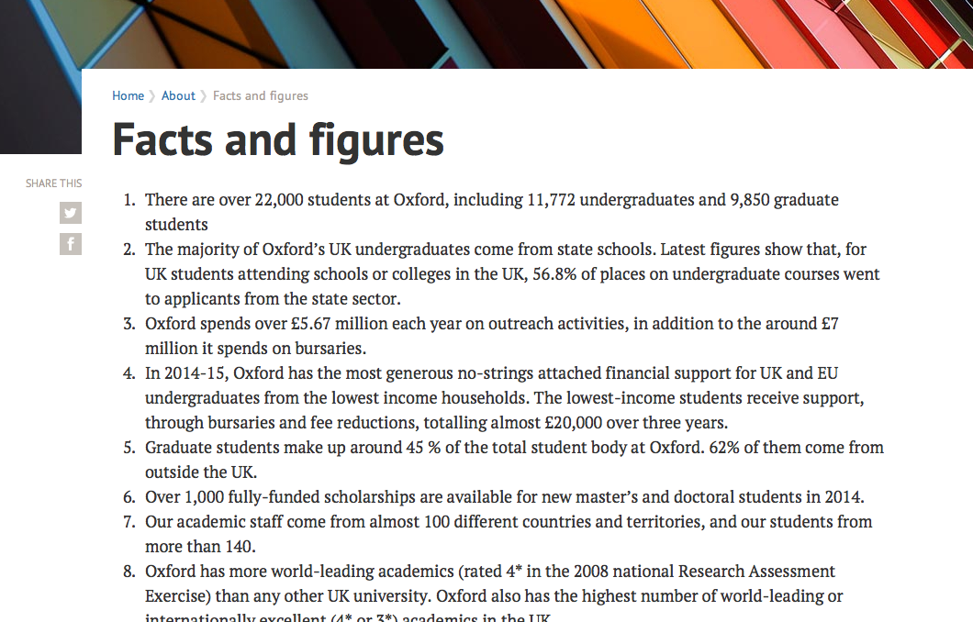
Public Affairs Directorate

Slide 17
Public Affairs Directorate
Year in review
ox.ac.uk/about/introducing_oxford/annual_review
Research impact
ox.ac.uk/research/research-impact/impact-films
∂
London and China lectures
ox.ac.uk/news-and-events/The-University-Year
∂

Slide 18
Public Affairs Directorate
The set of ideas a company or product stands for in people’s minds
Shaped by that company or product’s actions
And recognised through a visual style

Slide 19
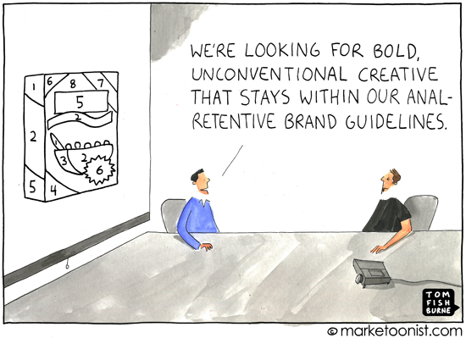
Public Affairs Directorate

Slide 20
Public Affairs Directorate
We are looking for inspirational design with impact and clarity that is consistent with Oxford’s expansive visual identity.

Slide 21
Public Affairs Directorate

Slide 22
Public Affairs Directorate
Our visual identity is the graphic expression of who we are and what we represent. It has a major role to play in promoting a consistent and positive image of the University.

Slide 23
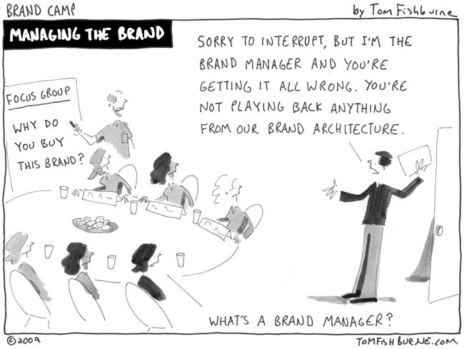
Public Affairs Directorate

Slide 24
Public Affairs Directorate
Brand Matters
1 May 2014 • Paul Chinn
Thanks to Tom Fishburne for the use of cartoons
http://tomfishburne.com
And to Wolff Olins for some content.
All photos are copyright to their respective owners.

