Slide 1
Measurement and reputation
Emma Duke, Head of Communications, Oxford Education, Oxford University Press
Tom Fryer, Ambitious Futures Graduate, PAD
Wednesday 14 June 2017

Slide 2
Today
Aim: enable you to apply reputation and campaign measurement in your own work.
A bit about reputation measurement
Campaign evaluation:
Objectives
AMEC framework

Slide 3
“Today we are in an all-out war for reputation. Our companies are battling to an unprecedented extent, for our most vital assets: our own identities.”
Miles White, Chairman & CEO, Abbott Laboratories

Slide 4
Reputation measurement
Reputation is based on perceptions
It is the aggregate perception of all stakeholders
It is comparative
It can be positive or negative
It is stable and enduring
Walker, K., 2010. A systematic review of the corporate reputation literature: definition, measurement, and theory. Corporate Reputation Review, 12 (4), pp. 357-387.

Slide 5
Reputation measurement study
How to measure reputation for not-for-profit organisations
Qualitative research among UK-based communications professionals working for not-for-profits
Charity, council, social housing, museum, publishing, and academic sectors represented
Notes:
Existing measures:
Fortune Most Admired Companies
Britain’s Most Admired Companies
Edelman Trust Barometer
RepTrak

Slide 6
Reputation measurement study
Variation in levels of measurement
Resource and financially expensive
Measurement by issue or stakeholder?
Performance important, if not profit
Gives communicators a voice on the Board and influences organisation decisions

Slide 7
A model
Mixed-method survey, examining opinions of an organisation based on:
Products and services, innovation, workplace, governance, citizenship, leadership, performance, and media reputation (inc. social)
Enables you to establish an organisation's aggregate reputation across all stakeholders, per issue

Slide 8
Campaign measurement

Slide 9
Why evaluate?
Puts you in the driving seat
Focuses effort on key targets
Demonstrates effectiveness
Cost efficiency
Good management
Accountability

Slide 10
Barcelona principles
Goal setting and measurement are fundamental to communication and public relations Measuring communication outcomes is recommended versus only measuring outputs The effect on organizational performance can and should be measured where possible | Measurement and evaluation require both qualitative and quantitative methods AVEs are not the value of communication Social media can and should be measured consistently with other media channels Measurement and evaluation should be transparent, consistent and valid

Slide 11
Objectives are key to evaluation
Set out measurable outcomes and guide the strategy
SMART
Link to evaluation:
Cognitive (output: awareness)
Affective (out-take: changing perception)
Conative (outcome: behaviour change)
Map to higher level objectives

Slide 12
Framework for an objective
To [raise awareness/change perception/change behaviour], from [%] to [%] among [audience], by [activity] within [time].

Slide 13
Example A: Innovation Comms
Mission: to project Oxford as a leader in innovation.
What objectives could be suitable?
To [raise awareness/change perception/change behaviour], from [%] to [%] among [audience], by [activity] within [time].
Notes:
Could define innovation – knowledge exchange, impact, commercialisation, and public engagement with research.
Could make the objectives measureable – ie an increase in behaviour.

Slide 14
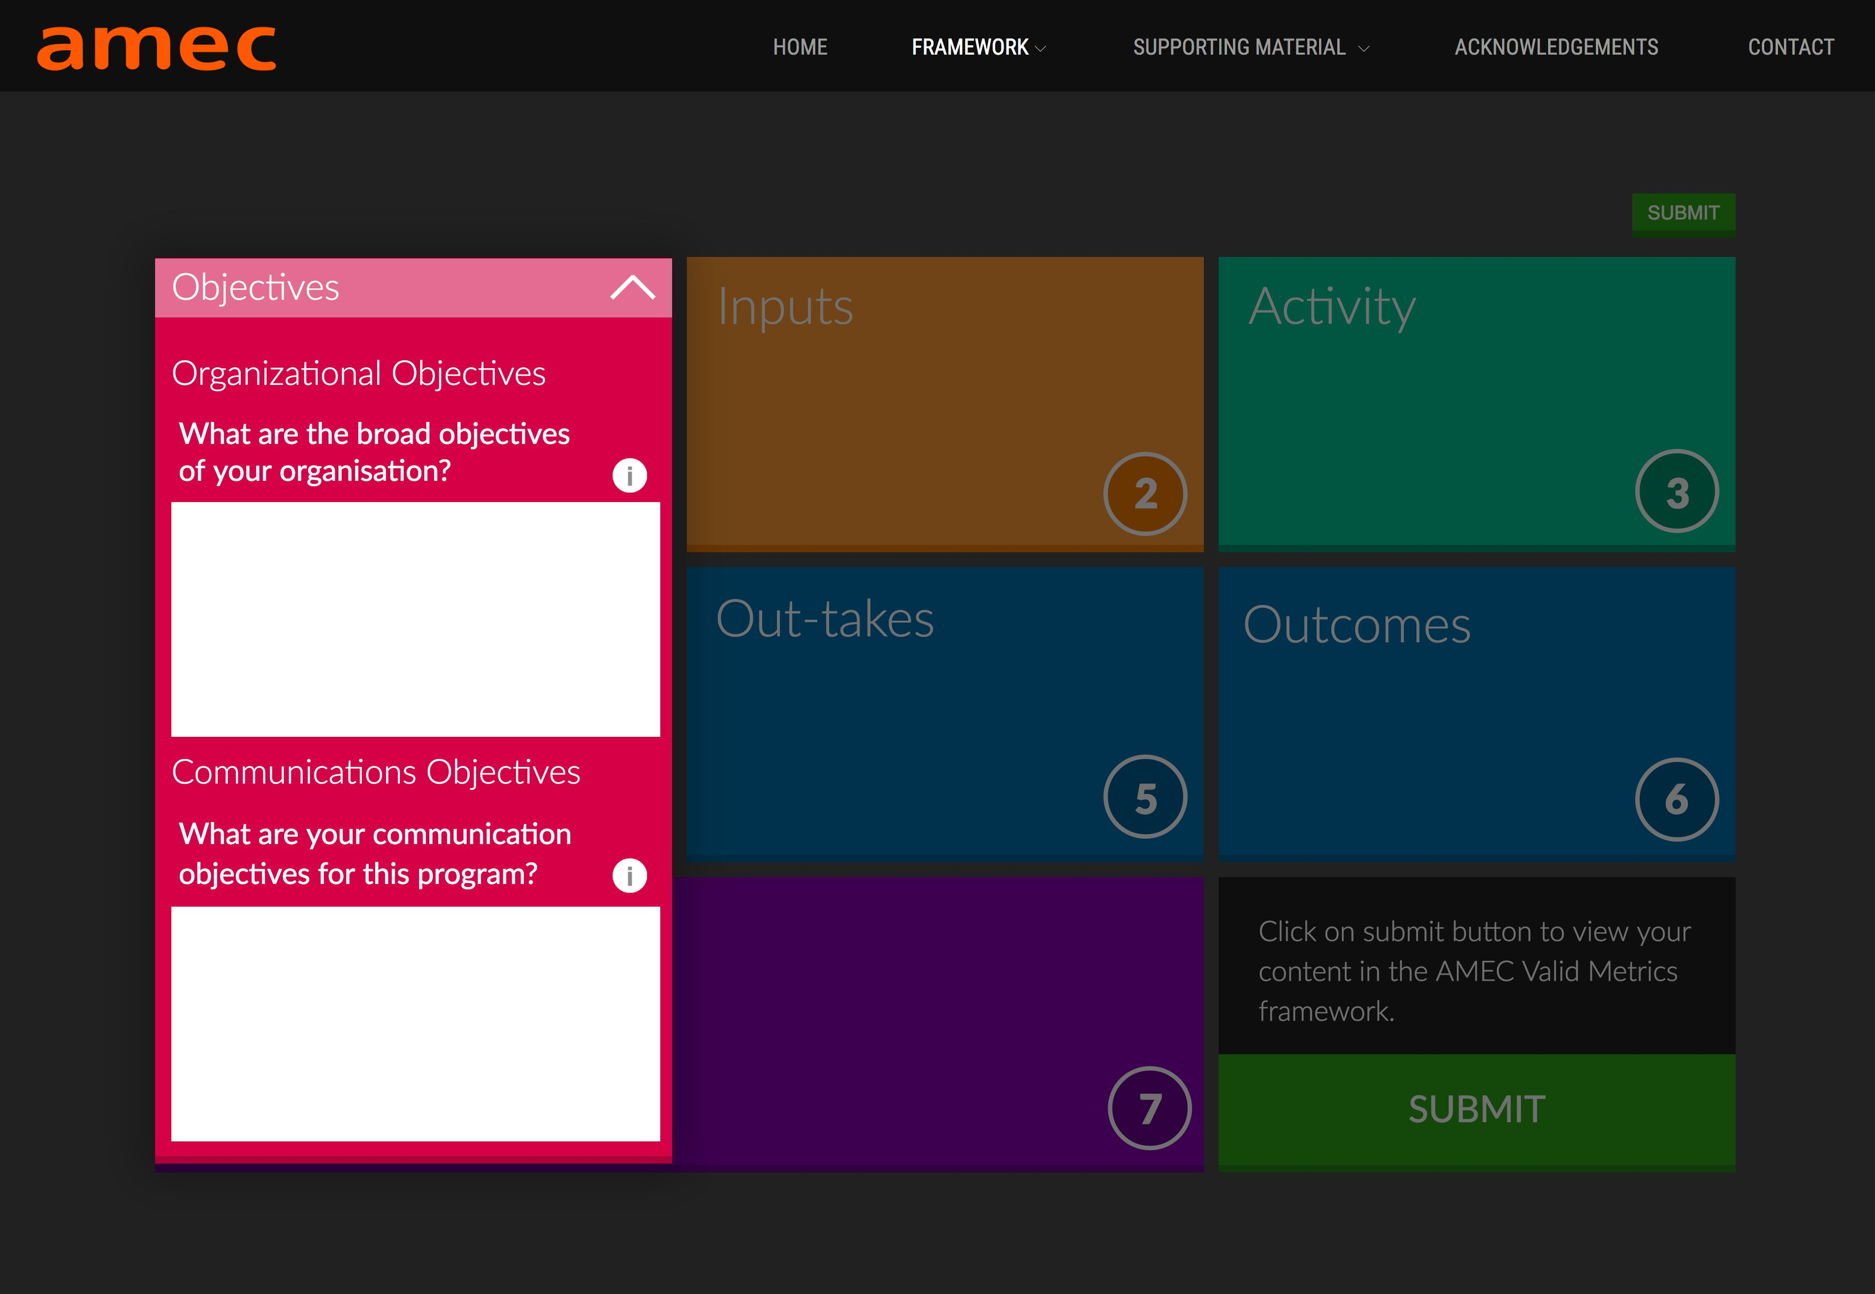
Notes:
CHALLENGE: For a campaign you are working on, or one of the examples here, set your organisational and communications objectives
Use handouts
Be ready to present back to the group in 15 minutes

Slide 15
Evaluation

Slide 16
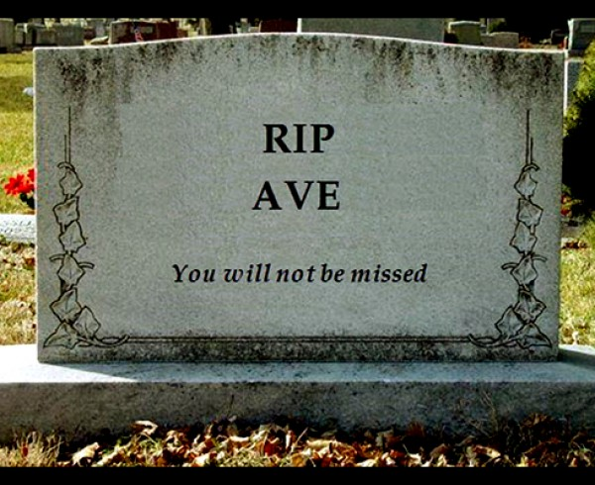
Notes:
CIPR: Members currently using AVEs will have a period of one year to complete a transition to valid metrics, which the CIPR will support with resources. Members found to be using AVEs thereafter may be liable to disciplinary action.
Why not? Inaccurate, ‘made up’, public relations has a more profound impact on business objectives than an artificial measure placed on the value of coverage.

Slide 17
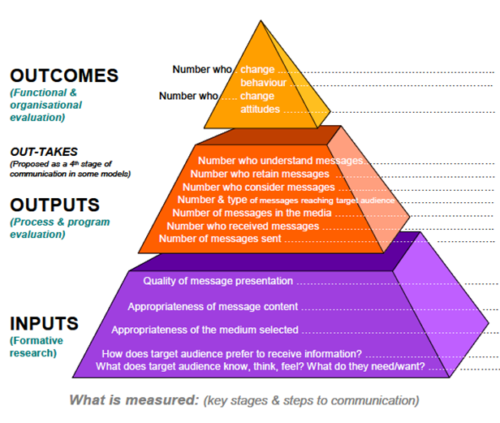
Effective evaluation is…
Research-based
Looks both ways
User-friendly
Short term
Long term
Comparative
Multi-faceted

Slide 18
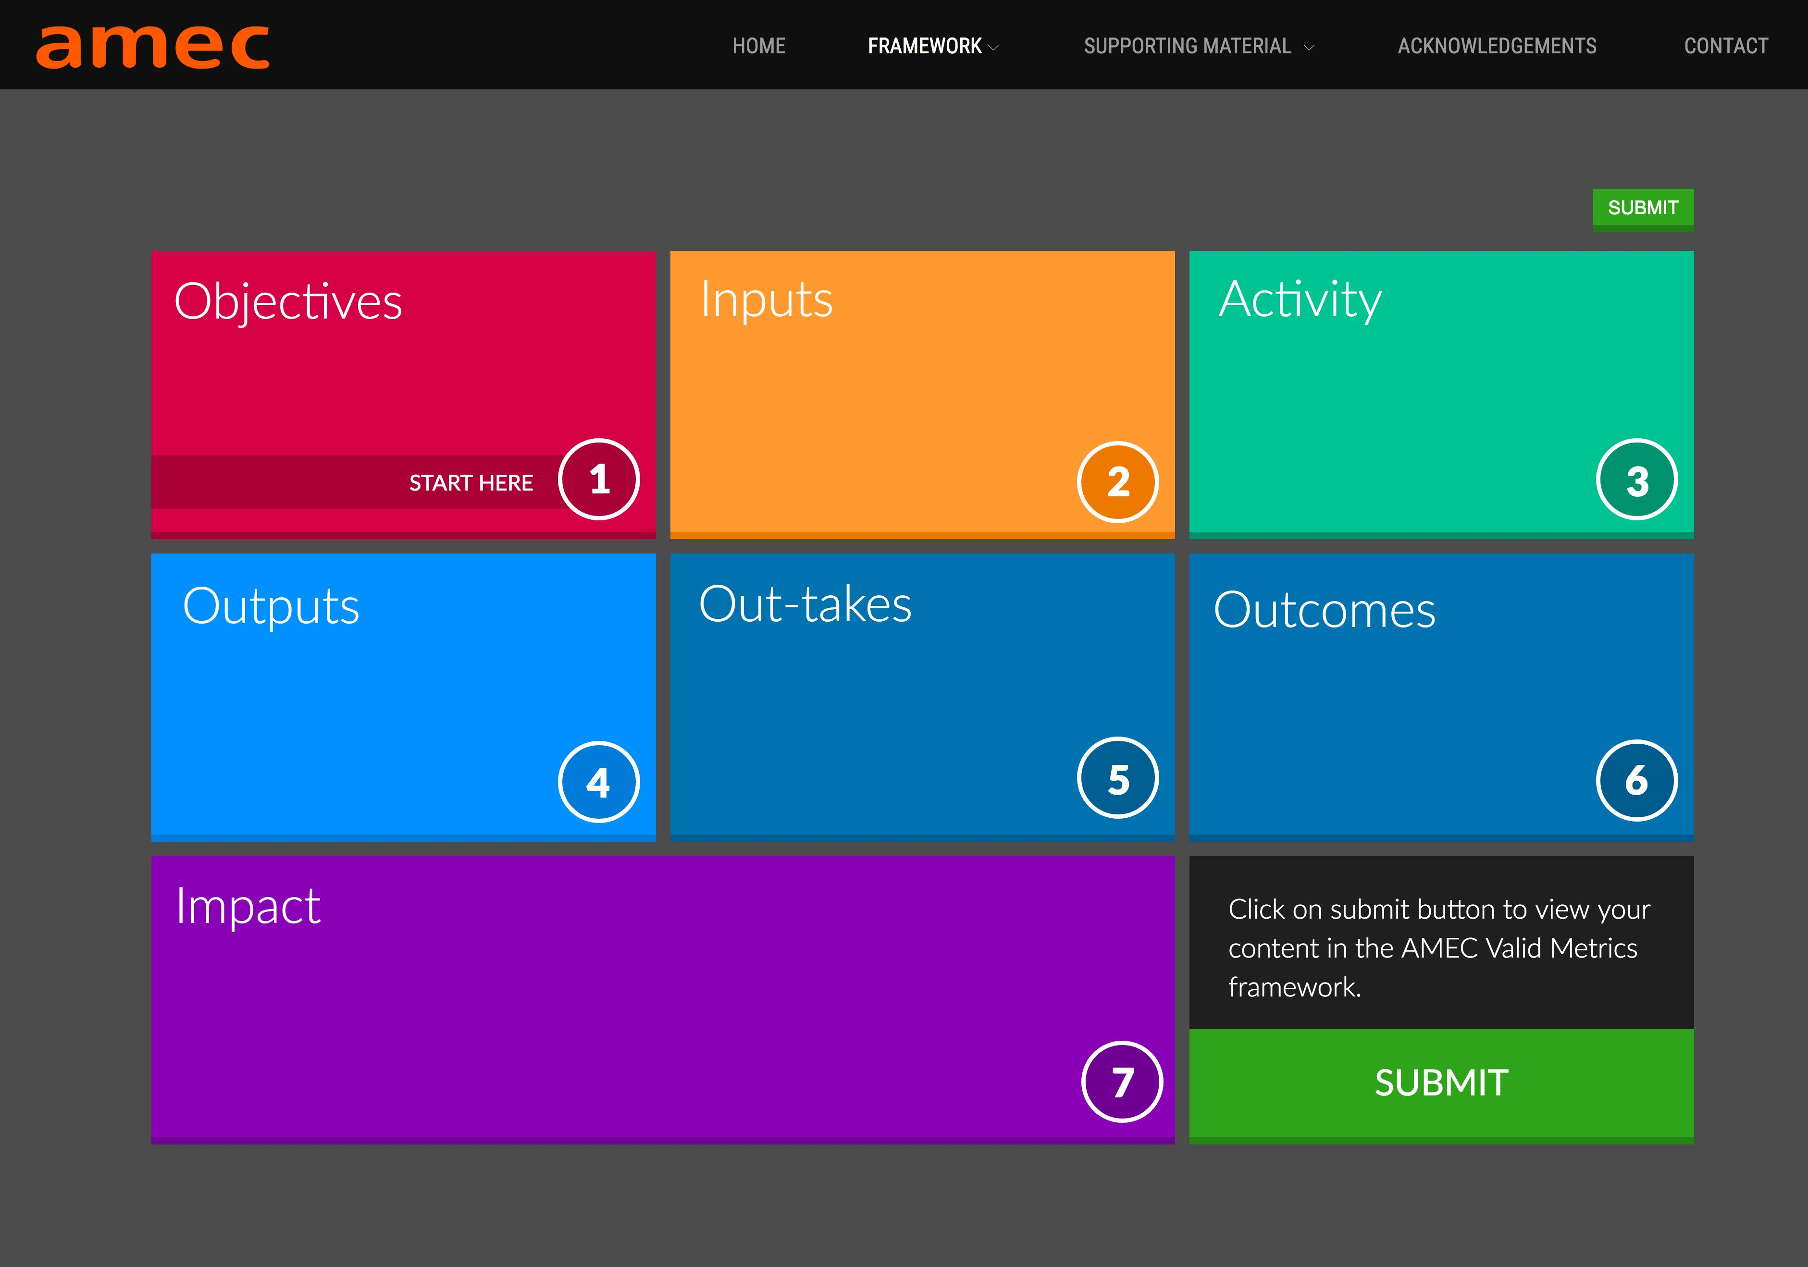
Notes:
Practitioners face a diverse and often confusing range of models, metrics, and methods, and a lack of standards, which are undoubtedly reasons that many practitioners still do not do evaluation based on rigorous methods.
An important breakthrough presented in this framework is that AMEC has looked beyond PR evaluation models to other fields and disciplines including performance management, public administration, organisational development, and advertising and marketing.

Slide 19
Inputs – target audience, existing research, context, budget
Activity – based on the PESO model to ensure campaign is integrated
Outputs – content and materials that you used to reach audience
Out-takes – what your audience took from your campaign and how they reacted to it
Outcomes – evidence of the effects on your target audience
Impact – how has the organisation been impacted during the campaign
Notes:
Inputs – target audience, existing research, context, budget
Activity – based on the PESO model to ensure campain is integrated
Outputs - content, materials, and activities that you distributed and to which your target audiences were exposed
Out-takes – what your audience took from your campaign and how they reacted to it
Outcomes – evidence of the effects on your target audience
Impact – how has the organisation been impacted during the campaign LINK TO REPUTATION

Slide 20
Example: Innovation Comms
Inputs
Activities
Outcomes
The resources needed to complete the activities (eg staffing, funding, time)
The actions that are taken to engage with audiences (eg publications, social media, events), and their reception.
Measurements
The changes in perception and/or behaviour of audiences (eg more research collaborations)
The metrics used to assess changes in outcomes.
Notes:
Stress that the AMEC framework is flexible.

Slide 21
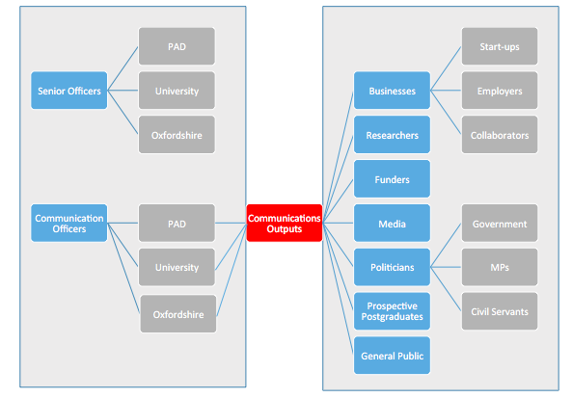
Example: Innovation Comms
Notes:
Map of audiences

Slide 22
Example: Innovation Comms
Objective | To increase the use of the University’s support for innovation, among potential business collaborators within 3 years.
Inputs | Activities | Outcomes | Measurements
Staff time (X hours) Funding (X amount, from these sources) | Social media posts Trade news articles Event at Oxfordshire Science Festival | Increased use website, facilities and research partnerships. | Website analytics Facilities use (HEBCI) Value of contract research (HEBCI) Qual interviews

Slide 23
Developing your own evaluation plan
Notes:
CHALLENGE: For a campaign you are working on, or one of the examples here, list some of the ways in which you would evaluate your campaign.
Use handouts
Be ready to present back to the group in 20 minutes

Slide 24
Notes:
CHALLENGE: For a campaign you are working on, or one of the examples here, list some of the ways in which you would evaluate your campaign.
Use handouts
Be ready to present back to the group in 20 minutes

Slide 25
Resources
‘Reputation measurement for not-for-profits – defining a new model’: emma.duke@oup.com
‘Planning and Managing Public Relations Campaigns’, Anne Gregory
Barcelona principles: https://amecorg.com/barcelona-principles-2-0/
AMEC framework: https://amecorg.com/amecframework/framework/interactive-framework/

