Slide 1
What the Industrial Strategy means to the academic community
Ian Campbell
Interim Executive Chair
@IanWCampbell
Notes:
Use this image if your presentation has a future of mobility focus

Slide 2


UK Research and Innovation: vision, mission and values
A research and innovation system that is fit for the future and able to respond to environmental, social and economic change on a global scale:
developing new ideas and technologies
to address the complex challenges facing
all societies around the world
helping the UK to make the most of its
world-class research and supporting its businesses to stay at the cutting edge
engaging the public in discussion about research and innovation

Slide 3

Benefiting everyone through knowledge,
talent and ideas.
Arts and Humanities Research
Council
Biotech and Biological Sciences Research
Council
Economic
and Social Research
Council
UK Research and Innovation brings together the
7 Research Councils, Innovate UK and Research England.
Engineering
and Physical
Sciences Research
Council
Innovate UK
Medical
Research
Council
Natural Environment Research
Council
Research
England
Science and Technology Facilities Council

Slide 4


Innovate UK
Innovate UK drives productivity and economic growth by supporting businesses to develop new ideas.
We connect businesses to the people that can help them, and fund businesses and research collaborations in all economic sectors, value chains and UK regions to accelerate innovation.
Notes:
Innovate UK drives productivity and economic growth by supporting businesses to develop and realise the potential of new ideas.
We connect businesses to the partners, customers and investors that can help them turn ideas into commercially successful products and services and business growth.
We fund business and research collaborations to accelerate innovation and drive business investment into R&D. Our support is available to businesses across all economic sectors, value chains and UK regions.

Slide 5

Investment of
Up to
Industry match funding taking
the total value of
projects above
Up to
£16bn
£7.30
£2.2bn
For every £1 we’ve invested
Since 2007
in added value
to the economy
£3.75bn
We’ve funded around
8,000
8 jobs
70,000
11,000
Unique
organisations
involved
For each organisation involved
Jobs created in total
projects

Slide 6
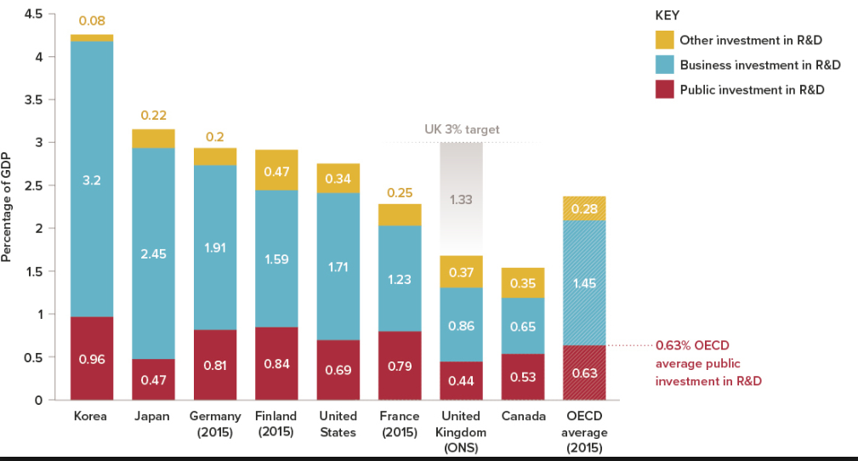
Global investment in R&D comparisons
UK 2.4% Target

Slide 7


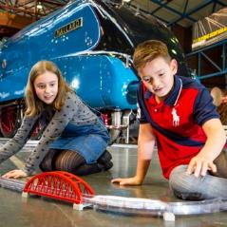



5 foundations of The Industrial Strategy
The Industrial Strategy is boosting boost productivity and earning power across the country by focusing on the 5 foundations of productivity, which support a vision for a transformed economy.
Ideas
The world’s most innovative economy
People
Good jobs and greater earning power for all
Infrastructure
A major upgrade to UK’s infrastructure
Business Environment
The best place to start and grow a business
Places
Prosperous communities
across the UK

Slide 8





Industrial Strategy Challenge Fund: Grand Challenges
AI and Data
Economy
Ageing
society
Clean
growth
Future of
mobility
Putting the UK at
the forefront of the artificial intelligence
and data revolution
Harnessing the power of innovation to help meet the needs of an ageing society
Maximising the advantages for UK industry from the global shift to clean growth
Becoming a world leader in shaping the future of mobility

Slide 9

Grand Challenge:
AI and the data-driven economy

Slide 10

Grand Challenge:
Ageing society

Slide 11

Grand Challenge:
Clean growth

Slide 12

Grand Challenge:
Future of mobility

Slide 13






ISCF challenges
Ageing society
AI & Data Economy
Future of mobility
Clean growth
Self-driving vehicles
Batteries for clean and
flexible energy storage
Manufacturing & materials
of the future
Robots for a safer world
Driving the electric revolution
Future of flight
Medicines manufacturing technologies
Data to early diagnosis
and precision medicine
Healthy ageing
Accelerating detection of disease
Satellites and
space technology
Audience of the future
Quantum technology
Next generation services
Made smarter
Energy revolution
Transforming construction
Transforming food production
Smart sustainable plastic packaging
Notes:
Waves 1, 2 and 3 (the three announced so far)

Slide 14

The Research and Innovation Landscape
Academic motivations for engaging in collaboration with business (Dowling Review, 2015)
“access real data”
“gives work meaning and purpose”
“experience the coal-face of industry”
“demonstrate impact”
“find funding for research”
“challenging problems”
“interesting problems”
“good job prospects”
“research making a difference”
“social value from research”
“connect theory with practice”
“technological advances”
“Industrial experience”
“access equipment & facilities”
“real-world problems”
“increase employability”
“lab-scale to industrial-scale”
“access networks”

Slide 15
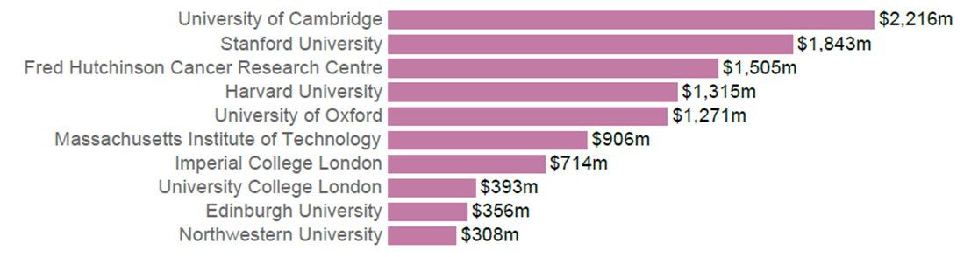
UK universities are relatively successful at commercialisation
Top universities by capital raised by their spinouts 2013-17
Source: Global University Venturing 2013-2017

Slide 16
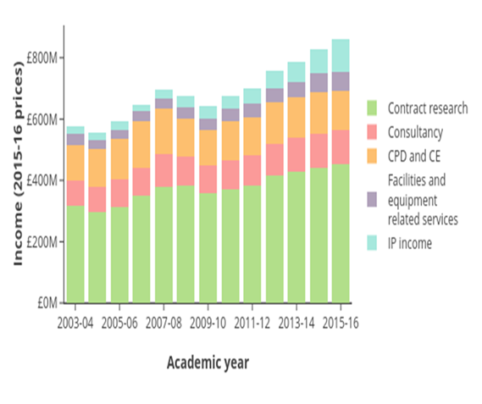
UK universities are increasingly good at working with businesses
Income from large businesses

Slide 17
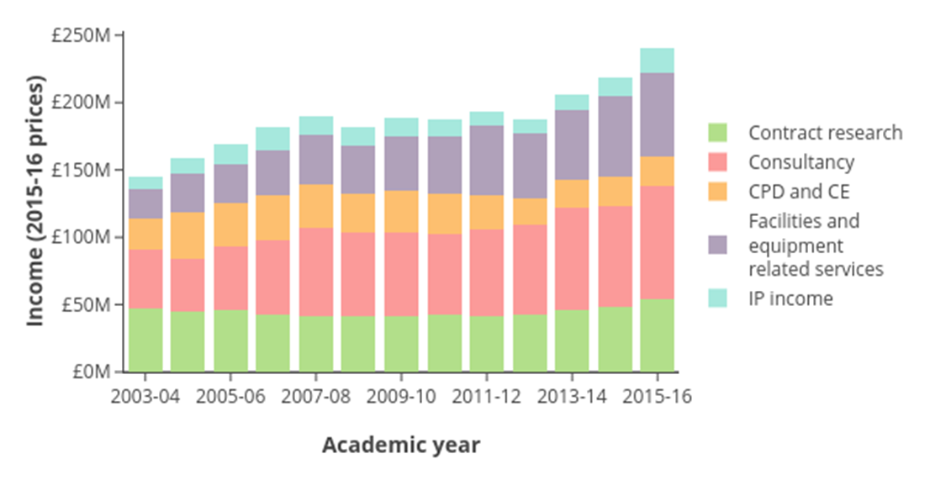
UK universities are increasingly good at working with businesses
Income from SMEs
Notes:
https://www.universitiesuk.ac.uk/facts-and-stats/data-and-analysis/Documents/patterns-and-trends-in-uk-higher-education-2018.pdf
UK universities’ knowledge exchange income has risen from £2.5bn in 2003-04 to £4.3bn in 2016-17, with much of this income from businesses
Support landscape is complex and can be difficult to navigate
SMEs can struggle to find the capacity to engage with research organisations
It can be hard to secure continuous funding for commercially promising ideas
UK has often missed ‘first mover’ advantage in emerging tech and industries
Spinouts and tech start-ups can find it hard to secure early stage investment
…and in the context of the 2.4% target we need to be ambitious.

Slide 18
How UKRI supports commercialisation
Research Organisation Capacity
Individuals & Skills
Research Push
Business Pull
Access to Finance
Networks, Brokerage & Facilities
Leadership, Incentives & Culture
External environment

Slide 19


Knowledge Exchange Framework
Research England is working with various stakeholders to develop the KEF, including Universities and UKRI
Evaluate and benchmark the contribution UK higher education institutions (HEIs) make to the exploitation of the knowledge they generate to improve effectiveness
Deadline for consultation survey – midday Thursday 14 March 2019
https://re.ukri.org/knowledge-exchange/knowledge-exchange-framework/

Slide 20
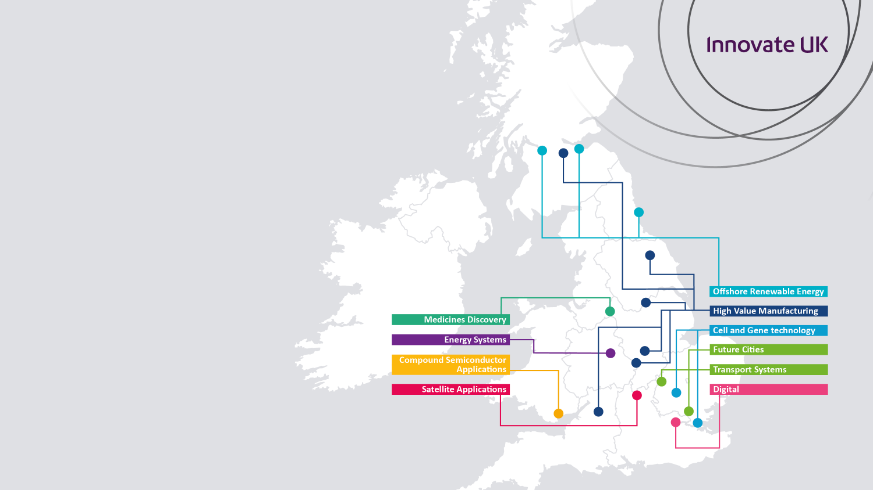
Catapult centres
Fostering innovation to
drive economic growth
established and overseen by Innovate UK
part of a network of technology and innovation centres
bridge the gap between businesses, academia, research and government
transforming the UK’s ability to create new products and services
ensure global opportunities for the
UK and sustained economic growth
for the future

Slide 21



Knowledge Transfer
Network (KTN)
Find markets.
Find solutions.
Find funding.
KTN is a network partner of Innovate UK. It helps businesses get the best out of creativity, ideas and the latest discoveries to strengthen the UK economy and improve people’s lives.
KTN links new ideas and opportunities from all sectors with expertise, markets and finance through a network of businesses, universities, funders and investors.
KTN supported clean-tech company FeTu

Slide 22
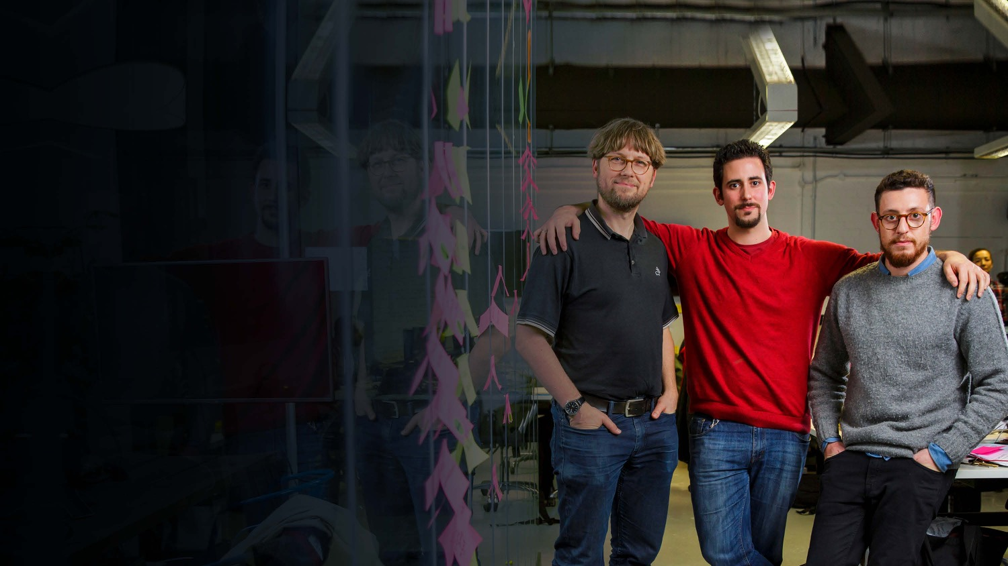

Knowledge Transfer
Partnerships (KTP)
KTPs help UK businesses innovate
and grow by linking them with an academic or research organisation and a graduate
a KTP enables a business to bring
in new skills and academic thinking
the academic or research organisation partner will help to recruit a suitable graduate
schemes last between 12 and
36 months
KTP partners Professor Udo Kruschwitz, Dr Miguel Martinez-Alvarez and David Benigson

Slide 23


Investment accelerator
The Industrial Strategy identified our investment accelerator model as a new approach to financing innovation, highlighting its potential to scale up businesses
Notes:
We are running 2 investment accelerator programmes in 2018 and 2019. A full evaluation of the model has been commissioned to examine the impact of the pilot and the results will be published between 2018 and 2019

Slide 24

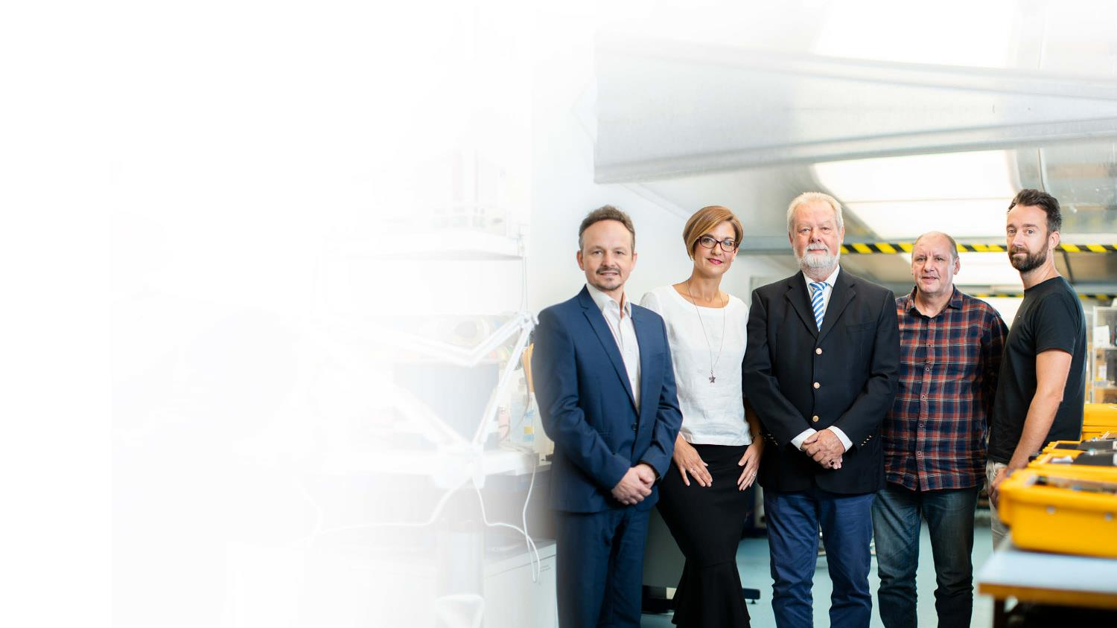

Innovation loans
A pilot programme of competitions to the end of 2019 aiming to ensure that businesses can access funding at all stages of innovation.
Up to £50 million available
Competitions
for UK SMEs wanting to scale up
Can be used for late-stage
R&D projects
Delivered by Innovate UK
Loans Ltd.

Slide 25

Innovate UK Smart funding
For businesses in any sector
enables businesses to apply for grant funding regardless of technical or industrial area of focus
funding for the best proposals in a competitive application process
5 open competitions run in 2018/19, each offering £20 million funding
Paul Holt, founder, Photocentric

Slide 26


Diversity and inclusion
At Innovate UK we are committed to encouraging diversity and inclusion in business innovation.
We want to find the best and most talented innovators from a diverse range of backgrounds, and provide them with the resources, advice and self-belief to succeed.
Our approach shines a spotlight where there is currently under representation in business innovation.

Slide 27


Women in Innovation
Encouraging and supporting diversity in innovation
we are working to ensure women’s ideas are heard and they have the support to turn them into successful businesses
we found that just 1 in 7 applications for our funding came from women
our first campaign saw a 71% uplift in women-led applications for support

Slide 28



Success stories: AI company Gyana makes ‘Cool’ list inside 2 years
Big data analysis platform uses AI to highlight trends across multiple data sources, including social media
The platform, GyanaAI, will empower people in their jobs
Gyana gained first customers following attendance at two missions partly supported by Innovate UK
“Innovate UK has been directly and indirectly connected in many ways...
I was introduced to Catapults which have been good allies.”
Joyeeta Das, Founder and CEO, Gyana

Slide 29

Ideas Mean Business
Encouraging and supporting diversity in innovation
In 2017 we partnered with the Prince’s Trust
on campaign encouraging more young people to develop their innovative business ideas.
11 regional innovation events across the UK, giving 150 young people innovative business advice and guidance
24 young people aged 18-30 received funding, an innovation mentor, and an allowance

Slide 30

Success Stories: Savings for the Ministry of Defence by Qioptiq
KTP with Cardiff Business School and associate Thanos Goltos reduced costs through leaner supply chain
opened new £3.7 million warehouse in North Wales to support £83 million contract with MoD
6-year contract will save MoD £47 million and ensure night-vision equipment available to UK forces worldwide
“It’s been a tough, enjoyable journey, and the results have been well worth the effort.”
Thanos Goltos, KTP associate

Slide 31


KTP leads to £500,000 investment
“The University of Oxford is delighted to establish this innovative partnership with the National Trust.
This flagship collaboration will create exciting opportunities for interdisciplinary research, knowledge exchange and public engagement with the National Trust’s inspiring places, collections, staff and visitors.”
Professor Karen O’Brien
Head of Oxford’s Humanities Division

Slide 32

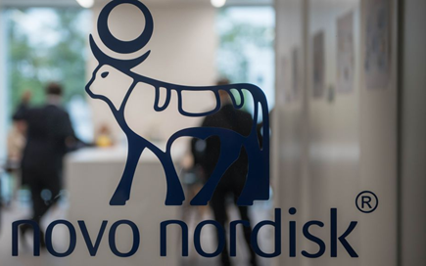
Success stories: University–industry collaborations to improve the lives of people with diabetes
Diabetes is the world’s fastest-growing chronic disease
Affects ~3.5 million people in Britain
85-95% cases are type 2 diabetes
Novo Nordisk Research Centre Oxford (NNRCO)
“Our vision is that the unique combination of industrial and academic know-how will eventually lead to a new generation of treatments to improve
the lives of people with type 2 diabetes.”
Mads Krogsgaard Thomsen, Chief Science Officer
and Executive Vice President of Novo Nordisk
Notes:
As featured in the NCUB State of Relationships Report 2018
http://www.ncub.co.uk/images/reports/NCUB-State-of-the-Relationship-Report-2018.pdf

Slide 33



Success stories: UKRI bringing research and innovation funding together
Bristol University spin-out Ziylo bought by Novo Nordisk
Ziylo was supported by UKRI funding :
  EPSRC
  Innovate UK, £500,00 Innovation and Commercialisation of University Research (ICURe) programme award
  Research England HEIF funded Technology Transfer capability

Slide 34
Maximising the commercial impact of the UK’s world class research base
Navigating support and funding opportunities:
  KTN, UKRI, Tech Transfer
Policy: deliver to national priorities and the Industrial Strategy grand challenges
Accessing funds: share best practice
Collaboration at the heart of innovation
  Connect with new people
  Outpace the competition
  Spark new ideas
Notes:
What do you think are the key enablers of commercialisation?

Slide 35
Thank you

